Slide 1
Simulation and parameter estimation with rxode2 and nlmixr²
nlmixr2 Course Uppsala 2024 Rik Schoemaker, PhD
On behalf of the nlmixr development team:
Matt Fidler, Bill Denney, Richard Hooijmaijers, Rik Schoemaker, Mirjam Trame, Max Taubert, Theo Papathanasiou, Justin Wilkins, John Harrold

Slide 2
Course outline
Introduction to rxode2 simulation
Introduction to nlmixr² and parameter estimation
Hands on with the warfarin PK models (part 1)
Advanced capabilities nlmixr²
Hands on with the warfarin PK and PKPD models (part 2)

Slide 3
rxode2 simulation software in R
rxode2 is pharmacometric simulation software using ordinary differential equations (ODEs) as an open-source R package
Rewritten by Matt Fidler after Wenping Wang’s original RxODE package, available on CRAN¹ and GitHub², and described in a tutorial in CPT:PSP³ and with online documentation⁴
Simulation of ODEs was already possible in R (using deSolve), but was slow and virtually impossible to code with flexible dosing history
rxode2 has rapid execution due to compilation in C
rxode2 allows fully flexible dosing history
Stable and mature software for Windows, OS X (in docker), Linux
Requires external compilers (provided by Rtools on Windows)
rxode2 is an evolution of the original RxODE package: after a full re-write of the code backward compatibility could not be guaranteed
[1] CRAN: https://cran.r-project.org/web/packages/rxode2
[2] GitHub: https://github.com/nlmixr2/rxode2
[3] Wang W et al. CPT:PSP (2016) 5, 3–10.
[4] RxODE packagedown: https://nlmixr2.github.io/rxode2

Slide 4
Basic example load the library and define the ODEs
library(rxode2)
## set up the system of differential equations (ODEs) odeKA1 <- " d/dt(depot) = -ka*depot; # This is compartment number 1 (depot) d/dt(central) = ka*depot-(cl/v)*central; # This is compartment number 2 (central) C1=central/v; # Calculates concentration from amount "

Slide 5
Compile the model and set the parameter values
library(rxode2)
## set up the system of differential equations (ODEs) odeKA1 <- " d/dt(depot) = -ka*depot; # This is compartment number 1 (depot) d/dt(central) = ka*depot-(cl/v)*central; # This is compartment number 2 (central) C1=central/v; # Calculates concentration from amount " ## compile the model modKA1 <- rxode2(model = odeKA1) ## provide the parameter values to be simulated: Params <- c(ka = log(2)/0.5, # 1/h (absorption half-life of 30 minutes) cl = 0.135, # L/h v = 8) # L

Slide 6
Create an eventTable that defines the doses and the sampling times
library(rxode2)
## set up the system of differential equations (ODEs) odeKA1 <- " d/dt(depot) = -ka*depot; # This is compartment number 1 (depot) d/dt(central) = ka*depot-(cl/v)*central; # This is compartment number 2 (central) C1=central/v; # Calculates concentration from amount " ## compile the model modKA1 <- rxode2(model = odeKA1) ## provide the parameter values to be simulated: Params <- c(ka = log(2)/0.5, # 1/h (absorption half-life of 30 minutes) cl = 0.135, # L/h v = 8) # L ## create an empty event table that stores both dosing and sampling information : ev <- eventTable()
## add a dose to the event table: ev$add.dosing(dose = 500) #mg
## add time points to the event table where concentrations will be simulated
## these actions are cumulative ev$add.sampling(seq(0, 120, 0.1))

Slide 7
Solve the equations and plot the results
library(rxode2)
## set up the system of differential equations (ODEs) odeKA1 <- " d/dt(depot) = -ka*depot; # This is compartment number 1 (depot) d/dt(central) = ka*depot-(cl/v)*central; # This is compartment number 2 (central) C1=central/v; # Calculates concentration from amount " ## compile the model modKA1 <- rxode2(model = odeKA1) ## provide the parameter values to be simulated: Params <- c(ka = log(2)/0.5, # 1/h (absorption half-life of 30 minutes) cl = 0.135, # L/h v = 8) # L ## create an empty event table that stores both dosing and sampling information : ev <- eventTable() ## add a dose to the event table: ev$add.dosing(dose = 500) #mg ## add time points to the event table where concentrations will be simulated
## these actions are cumulative ev$add.sampling(seq(0, 120, 0.1)) ## Then solve the system ## The output from rxSolve is a solved RxODE object, ## By making it a data.frame only the simulated values are retained: Res <- data.frame(rxSolve(modKA1, Params, ev))

Slide 8
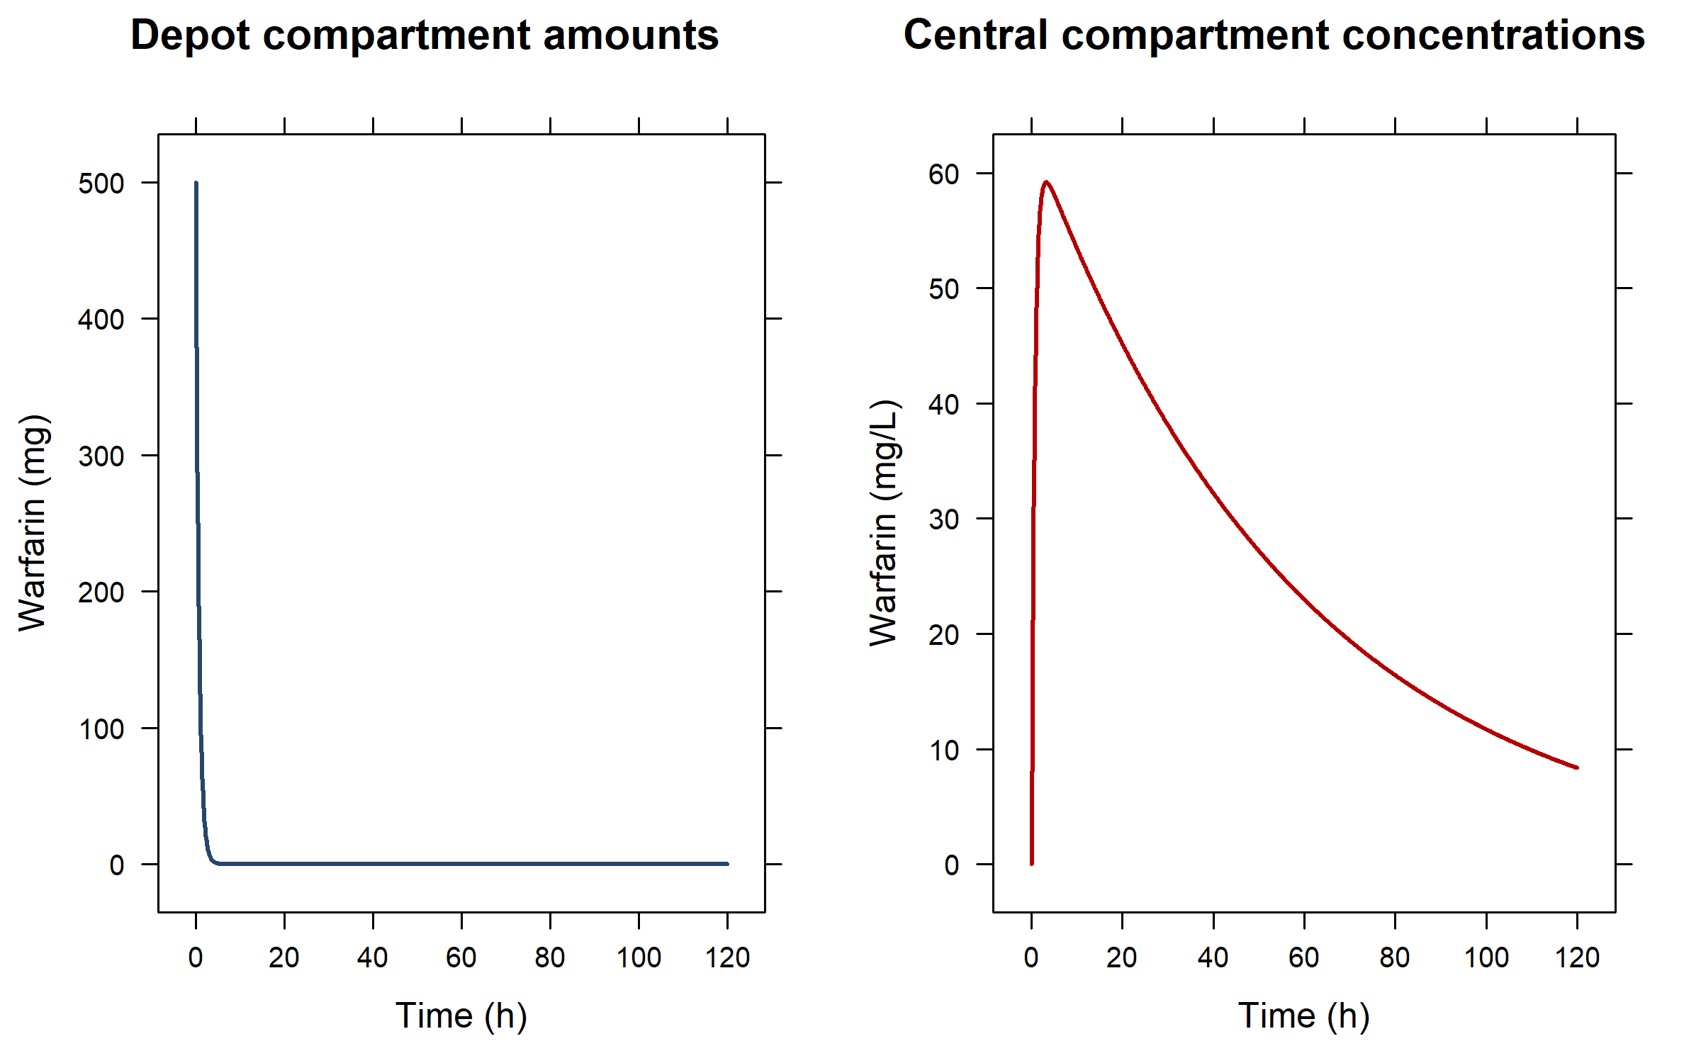
Single bolus dose in the first (depot) compartment

Slide 9
Adding extra doses (expand the existing eventTable): three additional infusions in the central compartment
## Extend the eventTable by adding three infusions to the central compartment ## Remember: updates to the eventTable are cumulative ev$add.dosing( dose = 250, #mg nbr.doses = 3, #add three doses dosing.to = 2, #add them to the second ODE in the model (=central) dosing.interval = 12, #h; set the doses 12 hours apart rate = 125, #mg/h; infuse at a rate of 125 mg/h, resulting in 2-hour infusions start.time = 36 #h; have the three doses start at 36h ) Res <- data.frame(rxSolve(modKA1, Params, ev))

Slide 10
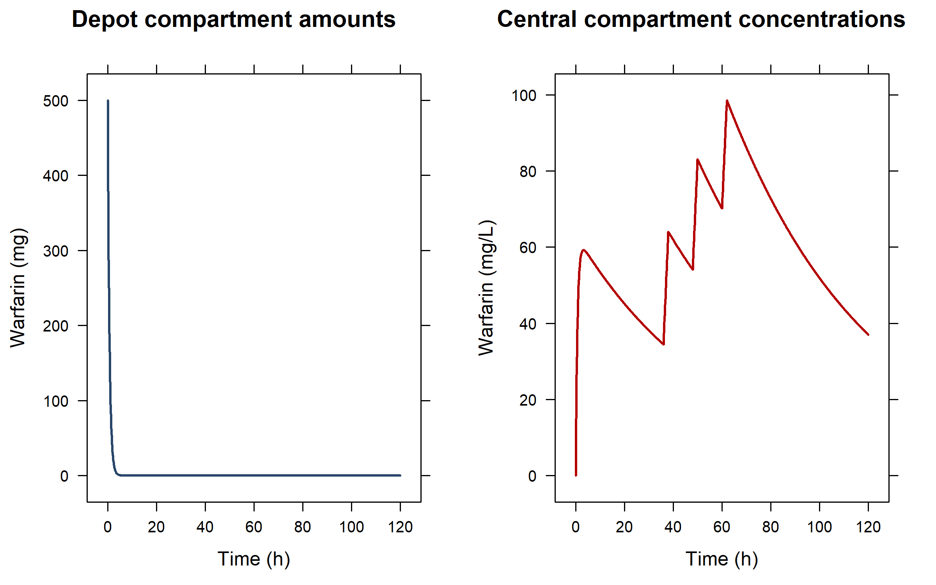
Multiple dose in different compartments Only the first dose goes into the depot (first) compartment

Slide 11
Extend the model: add a transit compartment…
odeKA1trans <- " d/dt(depot) = -ka*depot; d/dt(central) = ktr*trans-(cl/v)*central; # update to central: input from trans d/dt(trans) = ka*depot-ktr*trans; # transit compartment between depot and central C1=central/v; " ## compile the model modKA1trans <- rxode2(model = odeKA1trans) ## provide the extra ktr parameter: Params2 <- c( ka = log(2)/0.5, # 1/h (absorption half-life of 30 minutes) cl = 0.135, # L/h v = 8, # L ktr = log(2)/5) # 1/h (transit half-life of 5 hours) ## the eventTable does not have to change Res <- data.frame(rxSolve(modKA1trans, Params2, ev))
## if the trans compartment had been put as second compartment above,
## the eventTable would need an update to infuse in compartment 3 instead

Slide 12
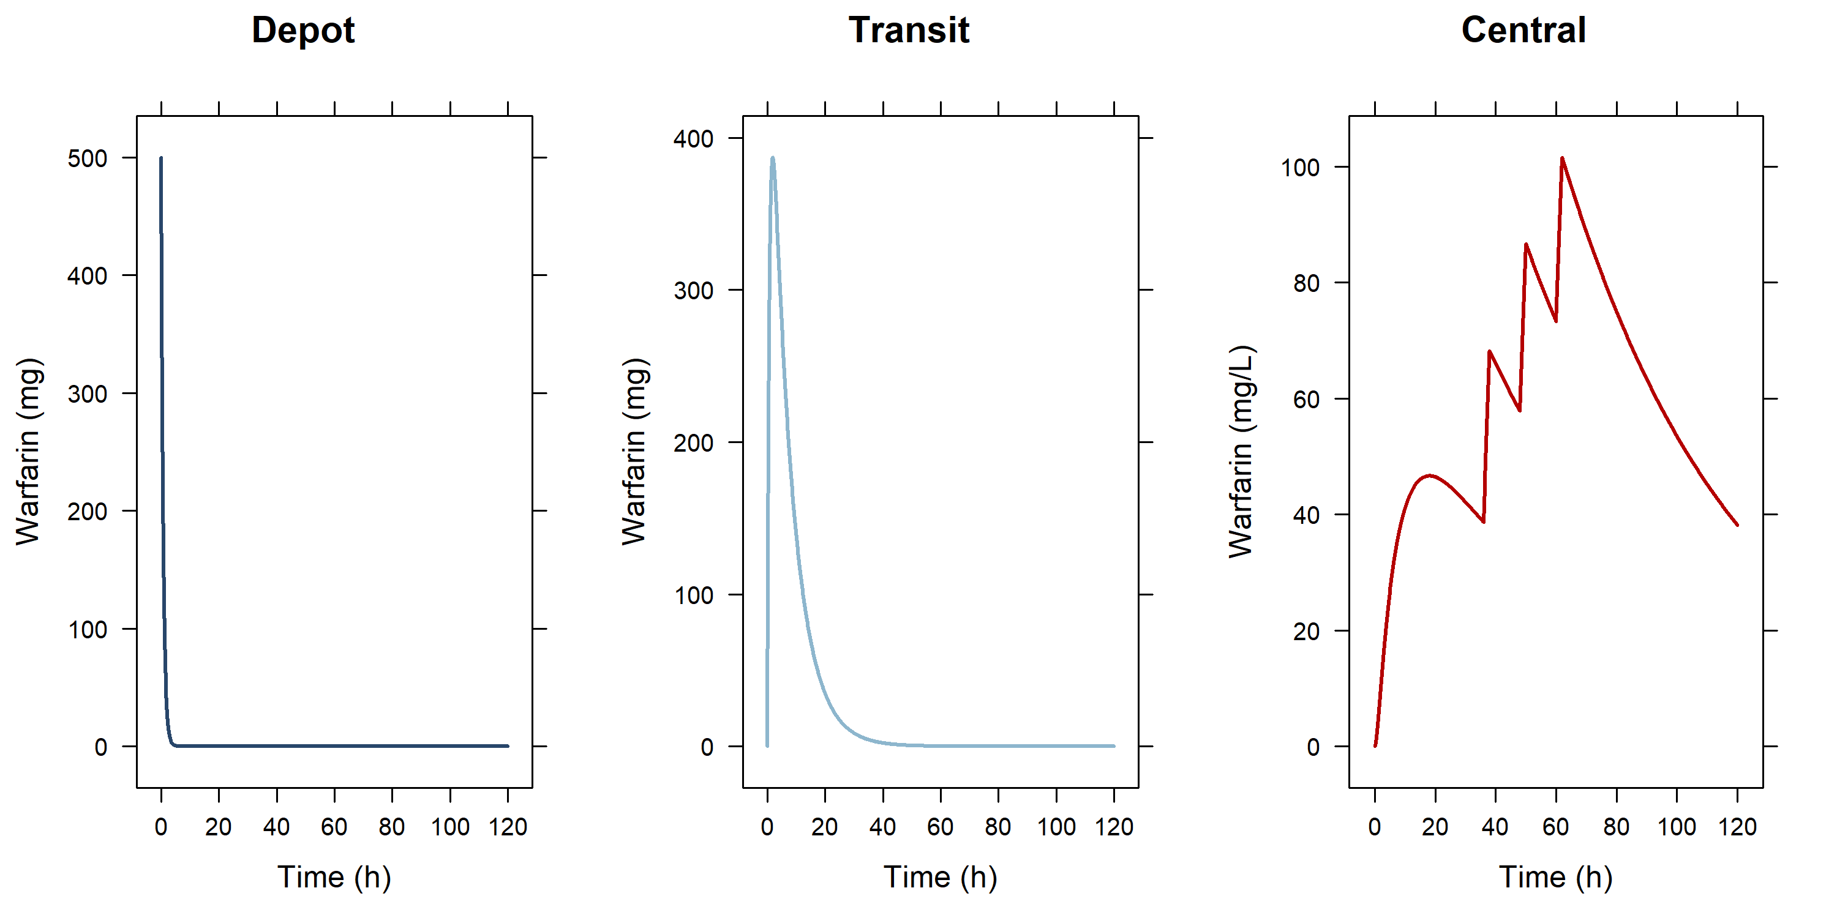
...adding a transit compartment between depot and central

Slide 13
Or with five transit compartments and only bolus doses in the depot…
odeKA5trans <- " d/dt(depot) = -ktr*depot; d/dt(central) = ktr*trans5-(cl/v)*central; # update to central: input from trans5 d/dt(trans1) = ktr*depot-ktr*trans1; # use same constant for every compartment d/dt(trans2) = ktr*trans1-ktr*trans2; d/dt(trans3) = ktr*trans2-ktr*trans3; d/dt(trans4) = ktr*trans3-ktr*trans4; d/dt(trans5) = ktr*trans4-ktr*trans5; C1=central/v; " ev3 <- eventTable() ev3$add.dosing(dose = 500) # mg; 1st bolus ev3$add.dosing( dose = 250, # mg nbr.doses = 3, # 3 additional doses (bolusses because rate is absent so rate=0)
dosing.interval = 12, # h; at 12 hour intervals dosing.to = 1, # dosed into depot (compartment 1) start.time = 36 # h; starting at 36 hours ) ev3$add.sampling(seq(0, 120, 0.1)) Params3 <- c(ktr = log(2)/1, # use same constant for every compartment cl = 0.135, v = 8) modKA5trans <- rxode2(model = odeKA5trans) Res <- data.frame(rxSolve(modKA5trans, Params3, ev3))

Slide 14
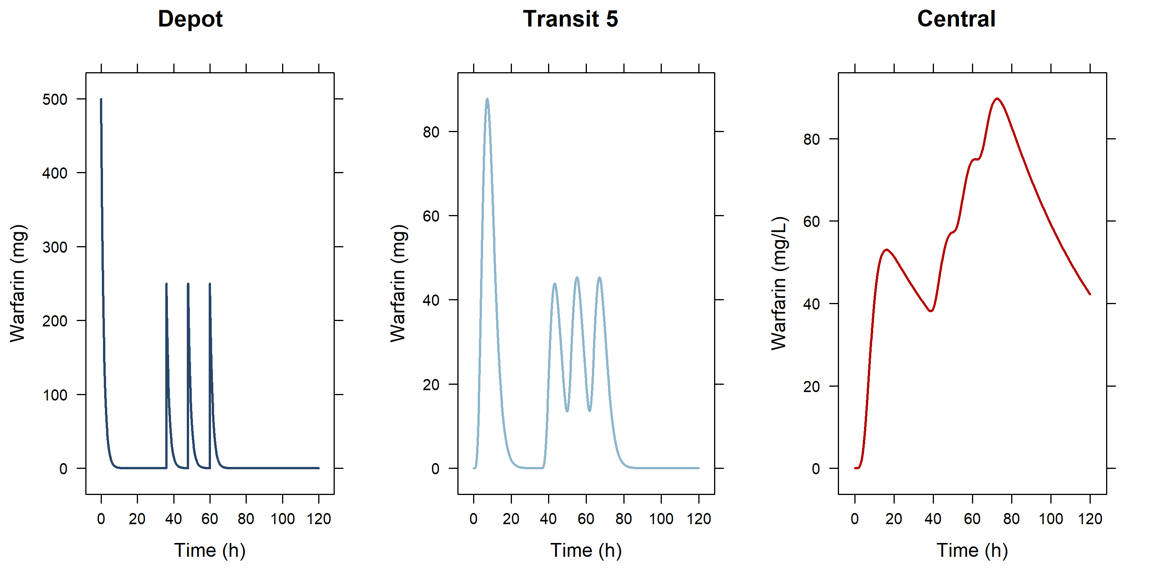
...adding 5 transit compartments between depot and central and giving 4 bolus doses in the 1st (depot) compartment

Slide 15
Hands-on session I: rxode2 simulations
Examine the code in PopSim_1.R to run pre-programmed simulations and try out your own variations

Slide 16
Assess the data before you start analysis
Classic data sets used by Nick Holford in his courses:
O'Reilly RA, Aggeler PM. Studies on coumarin anticoagulant drugs initiation of warfarin therapy without a loading dose. Circulation 1968;38:169-177
O'Reilly RA, Aggeler PM, Leong LS. Studies of the coumarin anticoagulant drugs: The pharmacodynamics of warfarin in man. Journal of Clinical Investigation 1963;42(10):1542-1551
Some simple plots to get a feel of the data
Additional xgxr functionality to improve and summarize the profiles

Slide 17
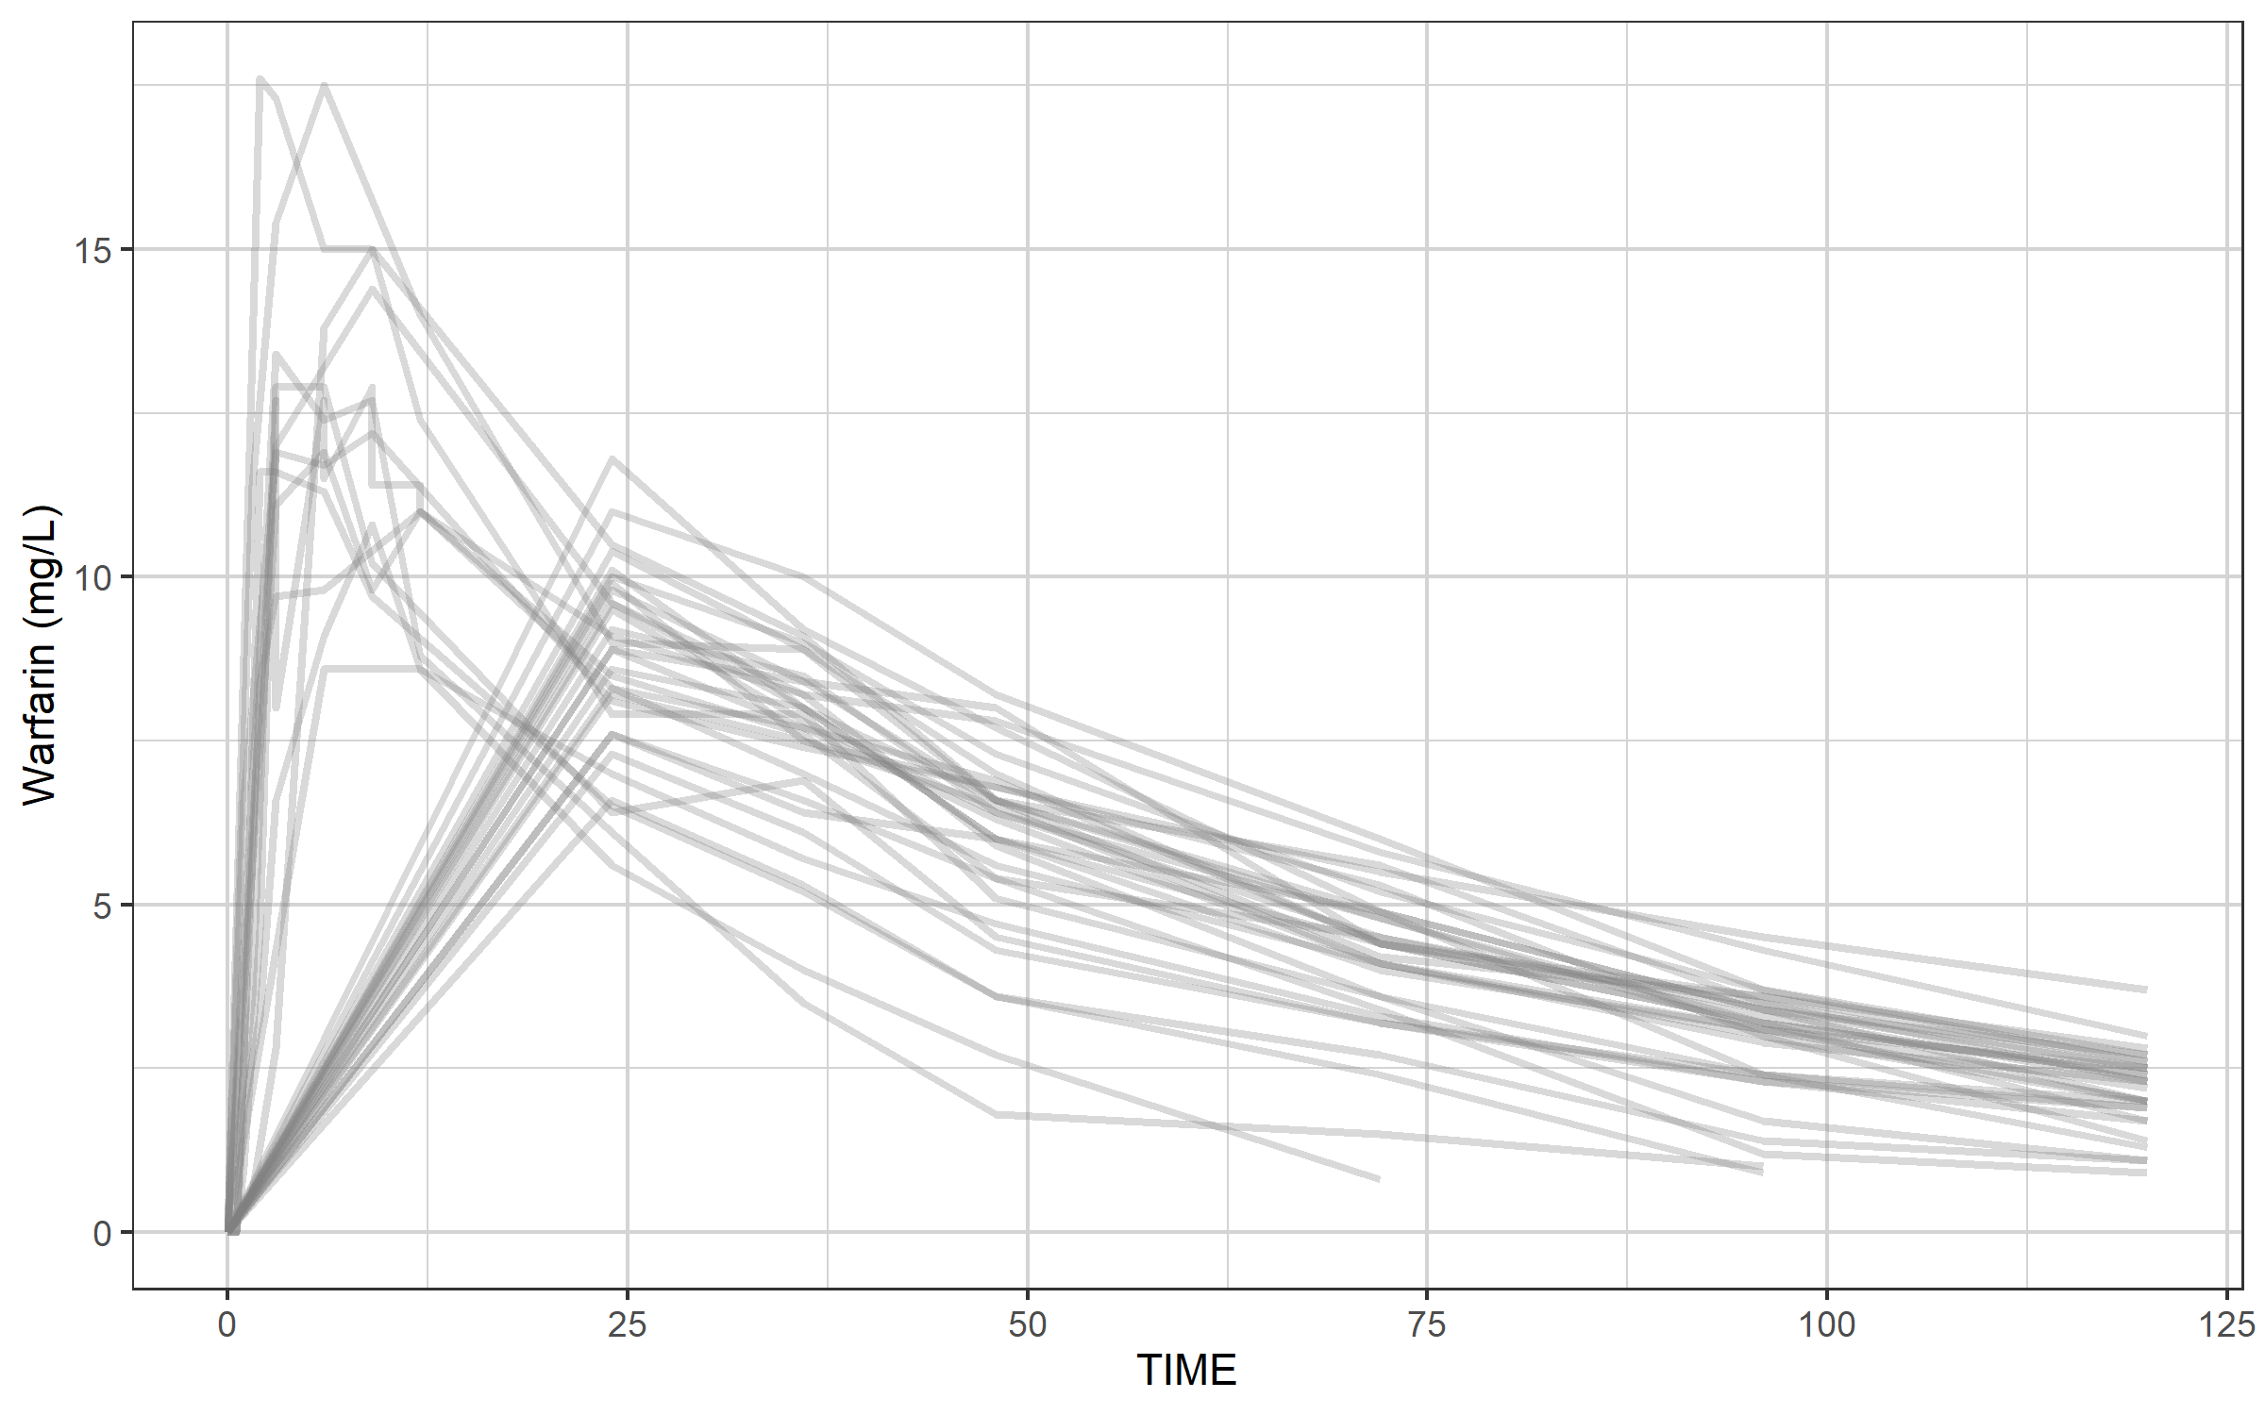
Our warfarin data file: a simple ggplot to provide an impression

Slide 18
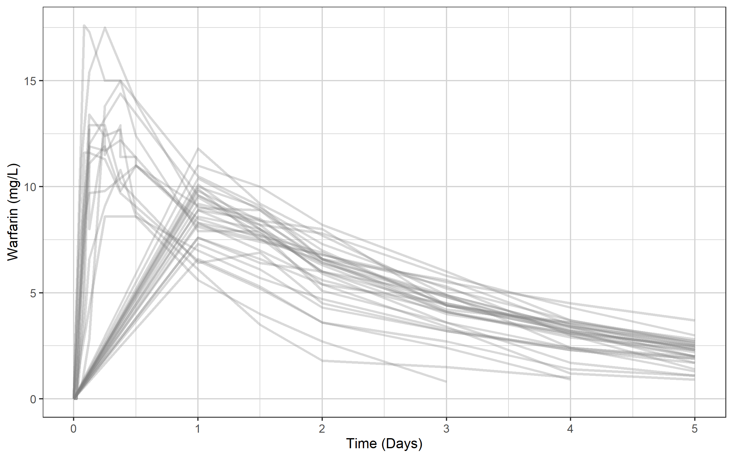
Change the x-axis from hours to days and add a proper label using the xgx helper xgx_scale_x_time_units(units_dataset = "hours", units_plot = "days")

Slide 19
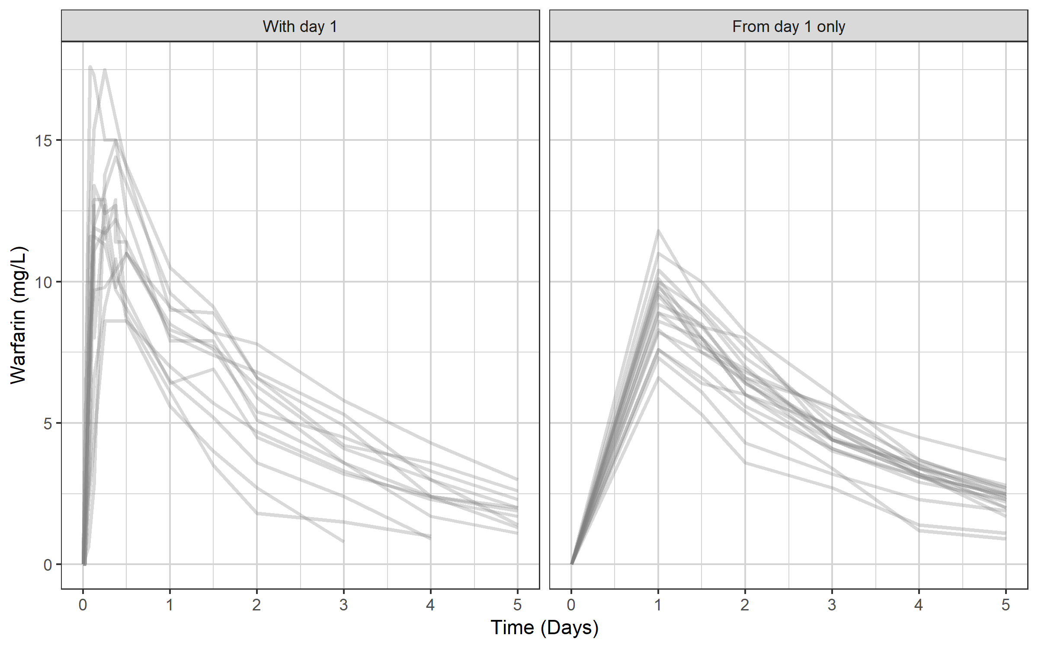
The data set has two types of profiles…

Slide 20
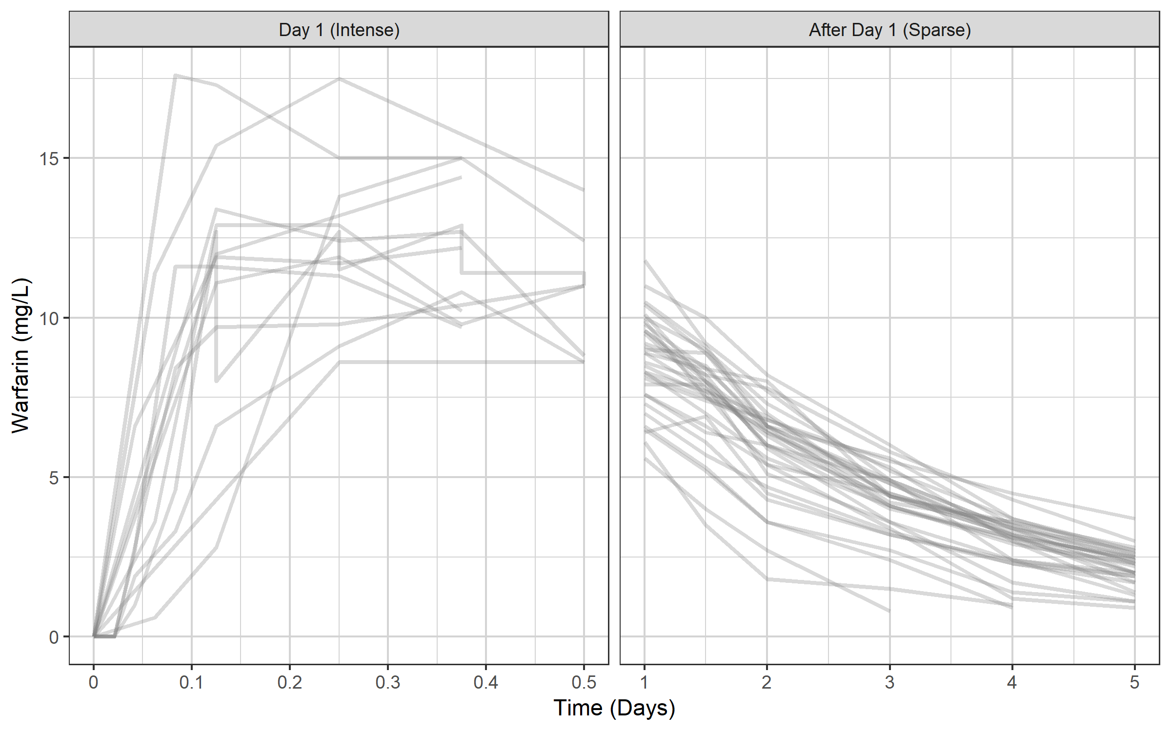
...but you can also group by rich day 1 and sparse later days...

Slide 21
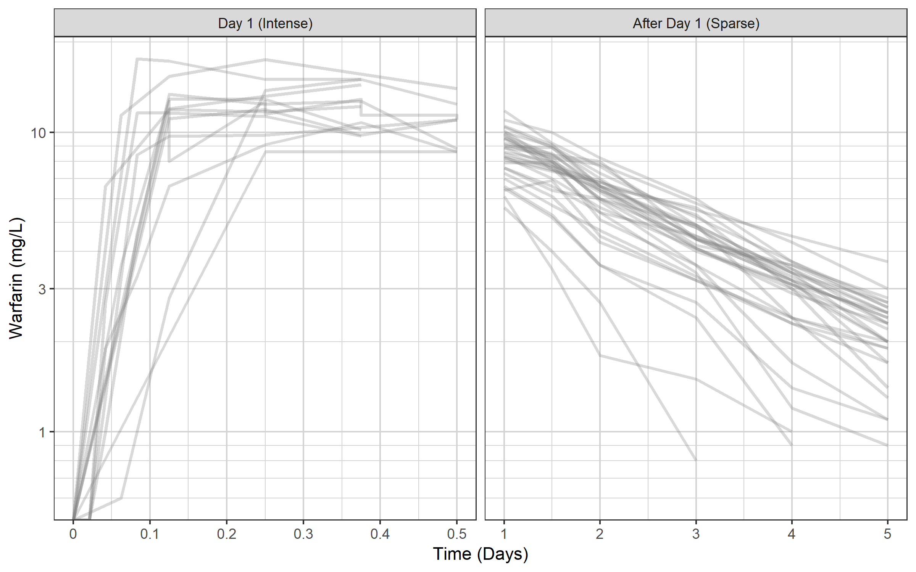
Switch to semi-log scale using xgx helper xgx_scale_y_log10() Any clues to what model we should use?

Slide 22
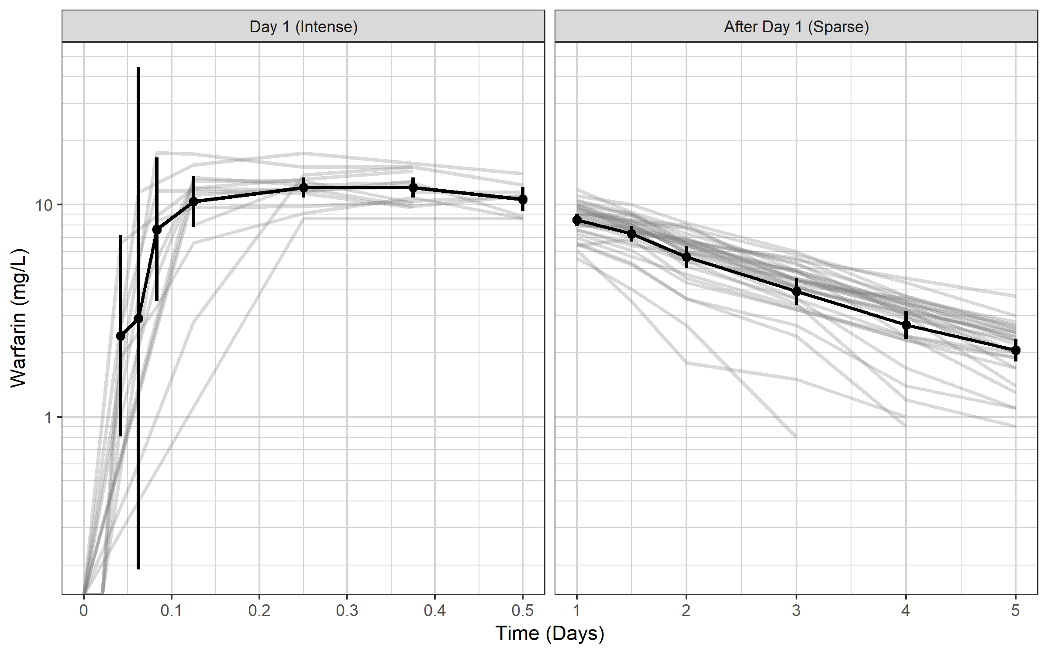
xgx can also add nice summary information if data has nominal times: summaries of mean plus 95% CI xgx_geom_ci(aes(x = TIME, color = NULL, group = NULL, shape = NULL), conf_level = 0.95)

Slide 23
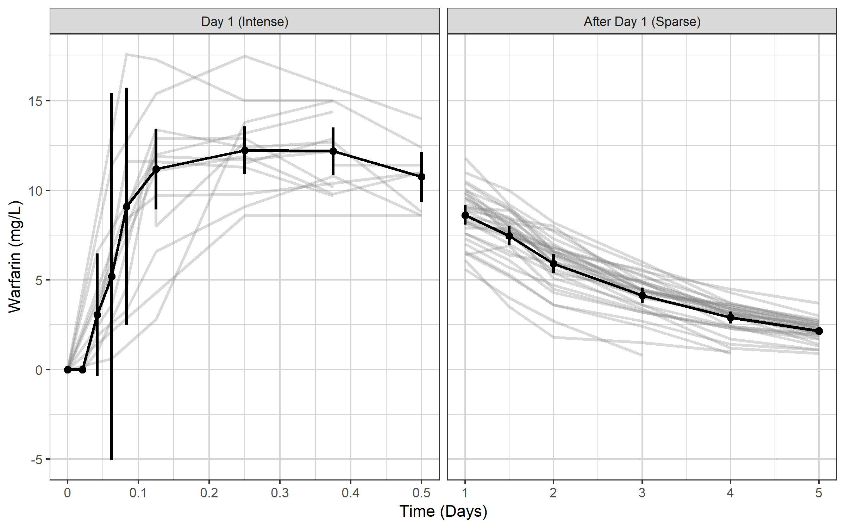
On linear scale this would result in a CI crossing zero because CIs are assumed symmetrical

Slide 24
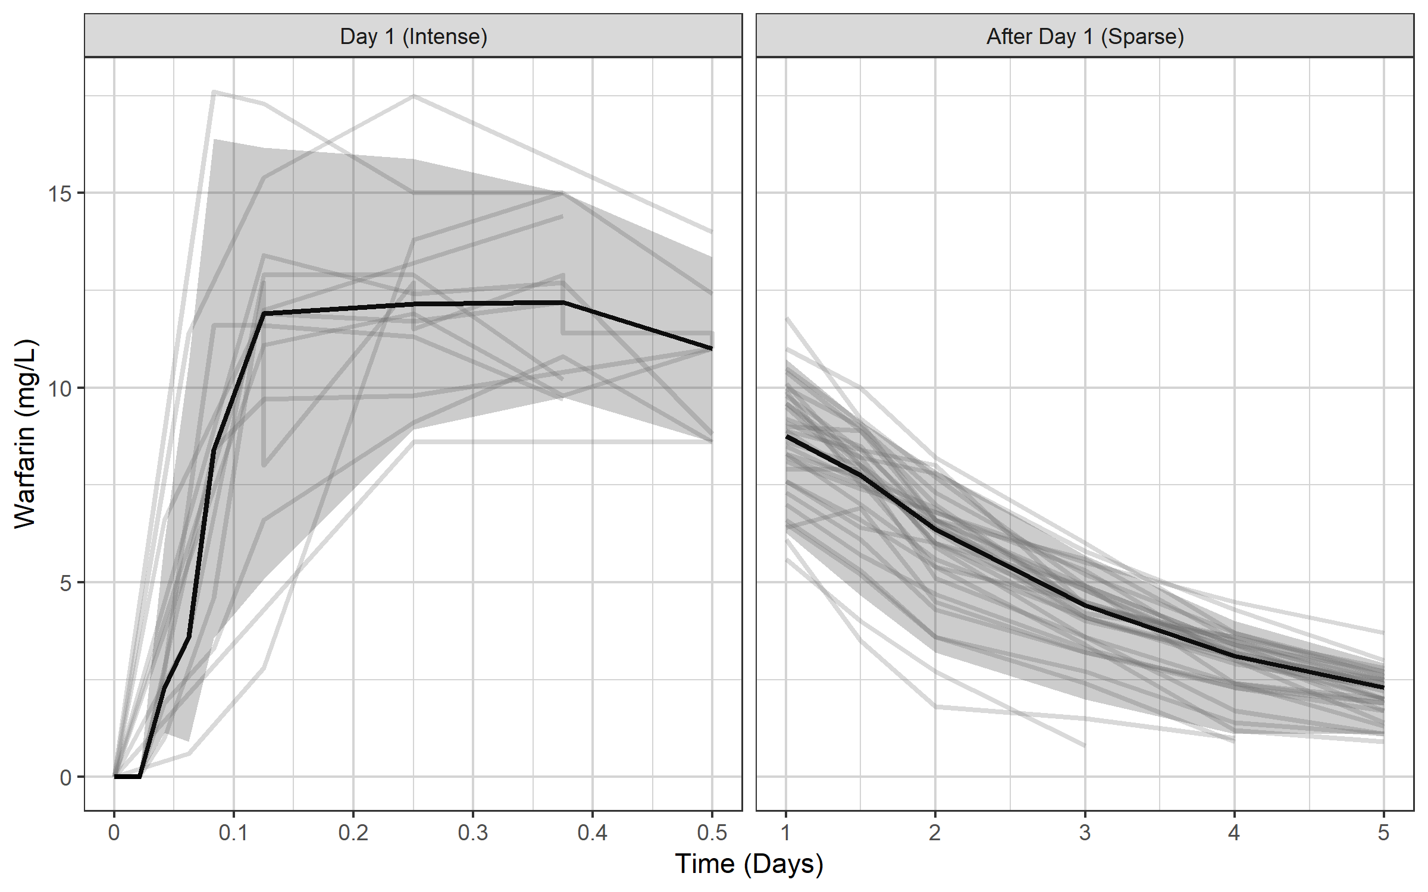
...so perhaps a median and 95% of the data would be more suitable xgx_geom_pi(aes(x = TIME, color = NULL, group = NULL, shape = NULL)

Slide 25
There appears to be a delay in absorption…

Slide 26
You need to simulate before you can estimate
With simulation covered, you can start to think about estimation
Combine the simulation core with estimation routines and you get:
nlmixr²!

Slide 27
nlmixr² is an open-source R package
Written by Wenping Wang and Matt Fidler, and available on CRAN¹ and GitHub²:
builds on rxode2
combined with SAEM, and FOCEi estimation routines, provides an R package for parameter estimation in nonlinear mixed effect models
under very active development!
nlmixr² is completely free and open source, and does not depend on any other commercial tool such as NONMEM or Monolix
nlmixr² provides an efficient and versatile way to specify pharmacometric models (both closed-form and ODEs) and dosing scenarios, with rapid execution due to compilation in C
[1] https://cran.r-project.org/web/packages/nlmixr2
[2] https://github.com/nlmixr2/nlmixr2

Slide 28
nlmixr² is a well-embedded open-source R package
nlmixr² is fully supported by ggPMX¹
Additionally, xpose.nlmixr2² written by Justin Wilkins provides linkage to the new xpose package³, written by Ben Guiastrennec, feeding the uniform output into a highly flexible diagnostics package
The shinyMixR⁴ project management tool written by Richard Hooijmaijers and Teun Post provides an interface to nlmixr² from both the R command line and a user-friendly browser-based Shiny dashboard application
nlmixr² requires access to compilers, easily installed using Rtools on Windows⁵
Installation is very simple from CRAN:
install.packages("nlmixr2",dependencies=TRUE)
Documentation is available in the form of a bookdown (nlmixr2.org)⁶ with a dedicated nlmixr blog (blog.nlmixr2.org)
Runs on Windows, Linux, and OS X, and a Docker install is available
[1] https://cran.r-project.org/web/packages/ggPMX/ and https://github.com/ggPMXdevelopment/ggPMX
[2] https://github.com/nlmixr2/xpose.nlmixr2 and https://cran.r-project.org/packages/xpose.nlmixr2
[3] https://cran.r-project.org/packages/xpose and https://uupharmacometrics.github.io/xpose/
[4] https://github.com/RichardHooijmaijers/shinyMixR and https://richardhooijmaijers.github.io/shinyMixR/articles/shinyMixR-vignette.html
[5] https://cran.r-project.org/bin/windows/Rtools/rtools42/rtools.html
[6] https://nlmixr2.github.io/nlmixr2

Slide 29
… and nlmixr² has some amazing new features!
nlmixr² can now use NONMEM for its parameter estimation when using the babelmixr2ª package
Additionally, babelmixr2 can use the PKNCA package to provide starting values for PK analysis when rich profiles are available, and can keep track of units
The nonmem2rx^{b} package allows reading in of NONMEM output and translation of NONMEM models (with a single epsilon error component) to nlmixr² objects
This allows checking of NONMEM models, additional calculation of covariance matrices where NONMEM failed, and nlmixr² functionality like creation of VPCs and smooth predicted individual profiles
[a] https://cran.r-project.org/web/packages/babelmixr2/index.html
[b] https://nlmixr2.github.io/nonmem2rx/index.html

Slide 30
nlmixr performance: do I get the same results when I switch from my usual estimation tool to nlmixr?
Publication in CPT:PSP: Performance of the SAEM and FOCEI algorithms in the open-source non-linear mixed effect modelling tool nlmixr¹
nlmixr/FOCEi compared to NONMEM/FOCEi
nlmixr/SAEM compared to Monolix/SAEM
Repeated sparse data sets for a single model
A wide range of models and inputs using single rich data sets
Results for both FOCEi and SAEM are perfectly comparable to NONMEM and Monolix
[1] https://ascpt.onlinelibrary.wiley.com/doi/10.1002/psp4.12471

Slide 31
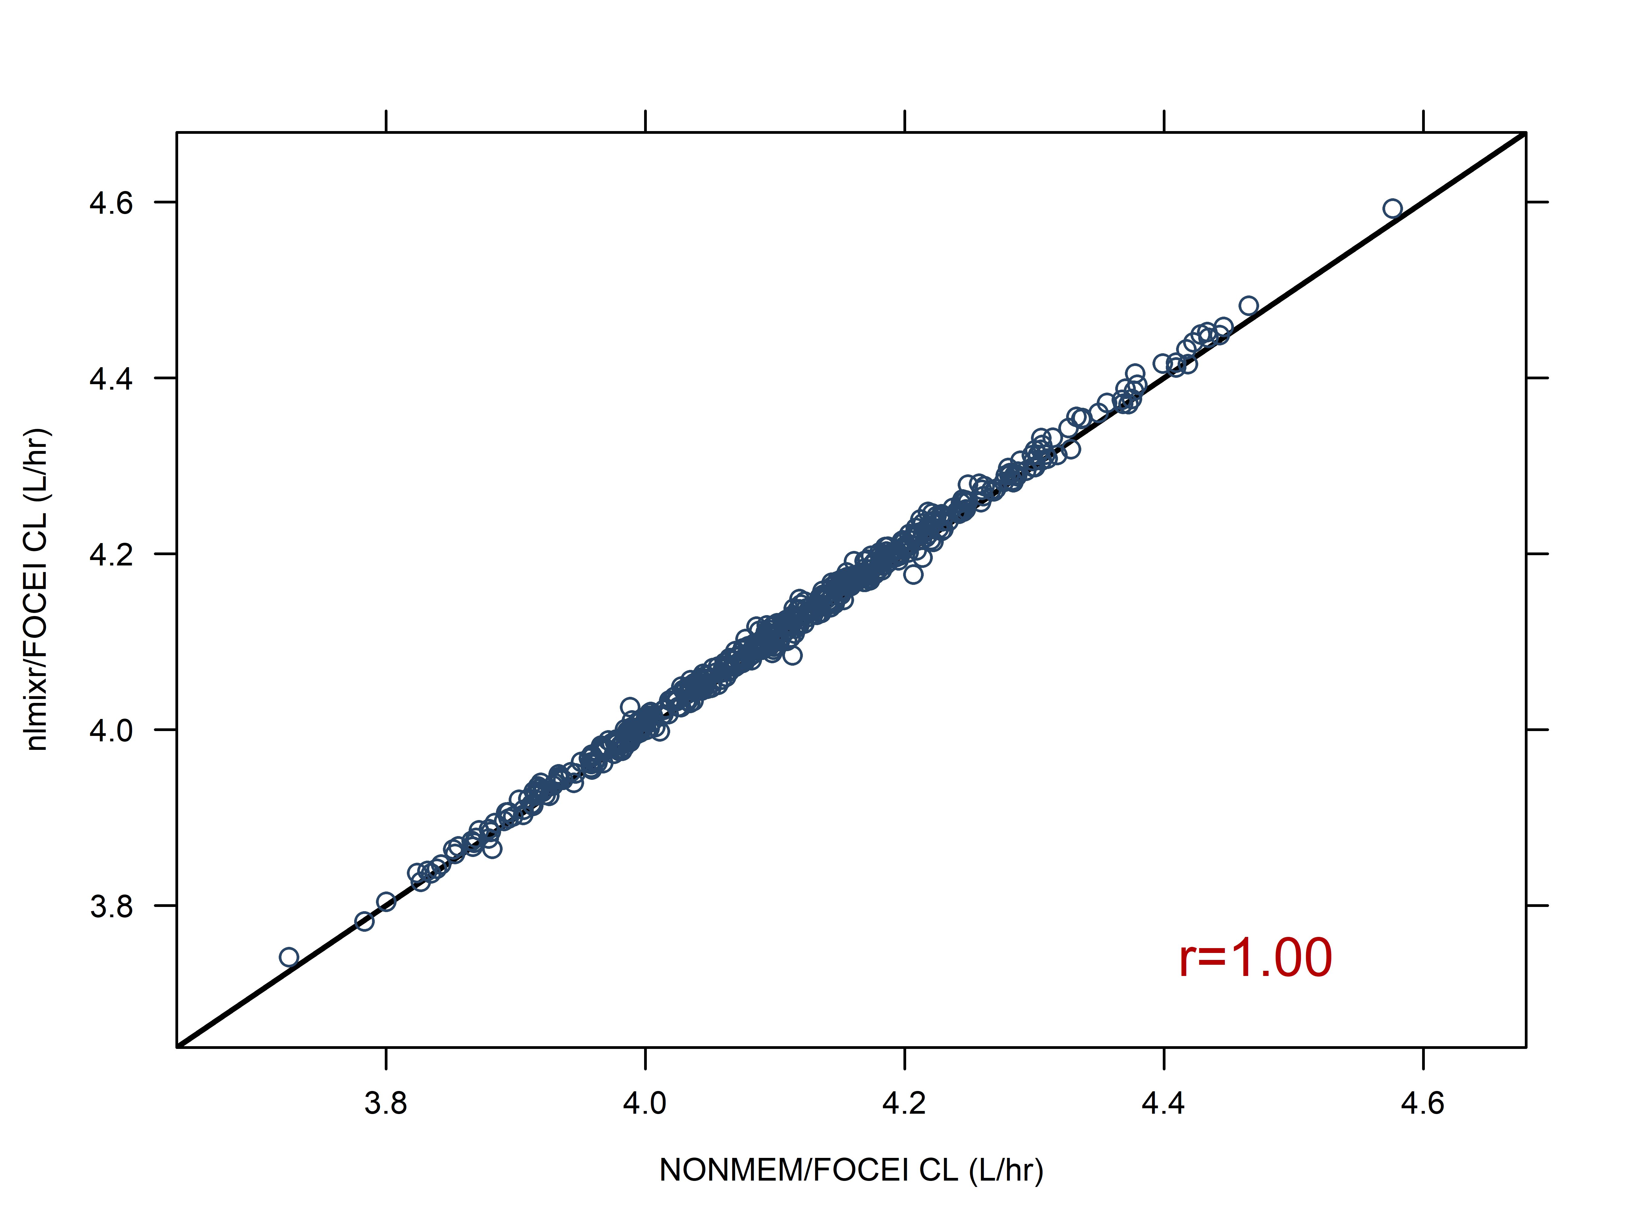
500 sparse data sets are analysed using both NONMEM/FOCEI and nlmixr/FOCEI. Each marker is a single paired data set result for clearance for NONMEM on the x-axis and nlmixr/FOCEI on the y-axis: results are highly correlated (r=1.00), and lie on the line of identity (diagonal black line)

Slide 32
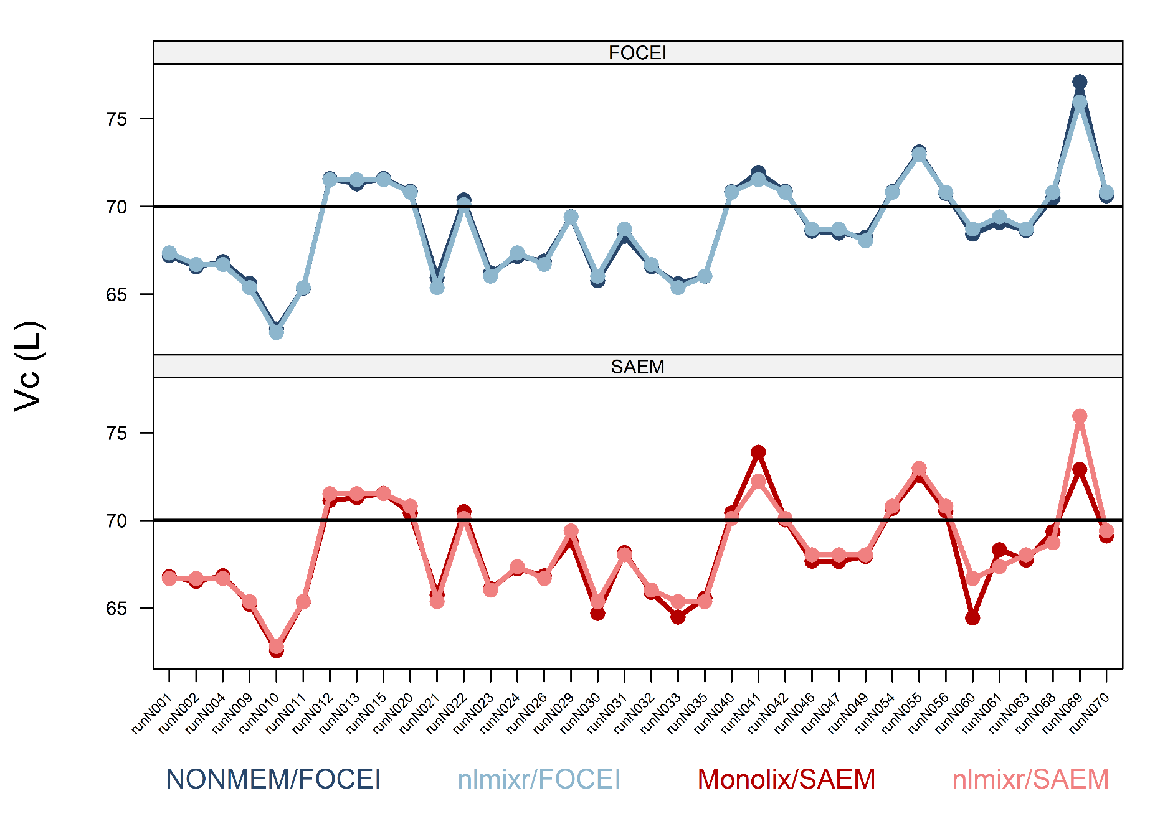
Central volume (Vc): Top panel: FOCEI estimates, bottom panel: SAEM estimates Dark lines: NONMEM/MONOLIX, light lines: nlmixr

Slide 33
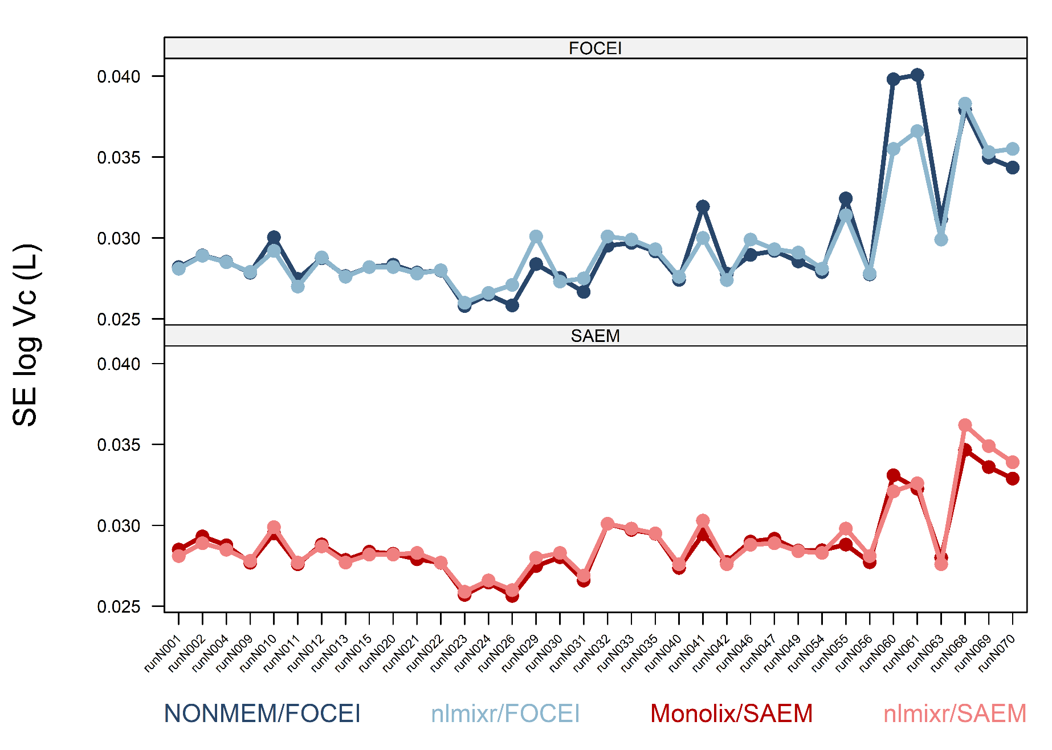
SE of theta estimates for Vc: very good match across software packages Top panel: FOCEI estimates, bottom panel: SAEM estimates Dark lines: NONMEM/MONOLIX, light lines: nlmixr

Slide 34
Defining nlmixr² models
Models are defined using a function containing an initialisation block (ini) and a model definition block (model)
One.comp.KA.solved <- function() { ini({ # Where initial conditions/variables are specified
}) model({ # Where the model is specified
}) }

Slide 35
Defining nlmixr² models
The ini block defines the parameters
Thetas and residual error defined using assign operators (<- or =)
Etas defined using a model formula (~)
Parameter names, starting values, labels for thetas and errors (using #), bounds for some estimation routines (like FOCEI)
One.comp.KA.solved <- function() { ini({ # Where initial conditions/variables are specified lka <- log(1.15) #log ka (1/h) lcl <- log(0.135) #log Cl (L/h) lv <- log(8) #log V (L) prop.err <- 0.15 #proportional error (SD/mean) add.err <- 0.6 #additive error (mg/L) eta.ka ~ 0.5 eta.cl ~ 0.1 eta.v ~ 0.1 }) model({ }) }

Slide 36
Defining nlmixr² models
The model block defines
the relationship between thetas and etas
the model structure using either closed-form solutions or ODEs
the residual error structure, and where it is applied
One.comp.KA.solved <- function() { ini({
}) model({ # Where the model is specified cl <- exp(lcl + eta.cl) v <- exp(lv + eta.v) ka <- exp(lka + eta.ka) ## solved system example ## where residual error is assumed to follow proportional and additive error linCmt() ~ prop(prop.err) + add(add.err) }) }

Slide 37
Running nlmixr² models: the full model
One.comp.KA.solved <- function() { ini({ # Where initial conditions/variables are specified lka <- log(1.15) #log ka (1/h) lcl <- log(0.135) #log Cl (L/h) lv <- log(8) #log V (L) prop.err <- 0.15 #proportional error (SD/mean) add.err <- 0.6 #additive error (mg/L)
eta.ka ~ 0.5 eta.cl ~ 0.1 eta.v ~ 0.1
}) model({ # Where the model is specified cl <- exp(lcl + eta.cl) v <- exp(lv + eta.v) ka <- exp(lka + eta.ka) ## solved system example ## where residual error is assumed to follow proportional and additive error linCmt() ~ prop(prop.err) + add(add.err) }) }

Slide 38
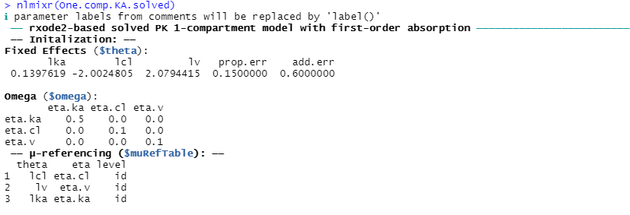
Running nlmixr² models: check the model code
## Check the model and some of the assumptions made by nlmixr
nlmixr2(One.comp.KA.solved)

Slide 39
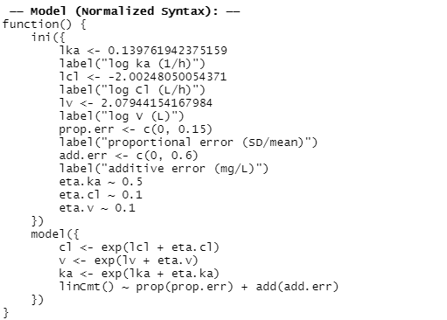
Running nlmixr² models: check the model code
## Check the model and some of the assumptions made by nlmixr
nlmixr2(One.comp.KA.solved)

Slide 40
Running nlmixr² models with the nlmixr2 command
## estimate parameters using nlmixr: fitOne.comp.KA.solved_S <- nlmixr2( One.comp.KA.solved, #the model definition PKdata, #the data set est = "saem", #the estimation algorithm (SAEM) #the SAEM minimisation options: saemControl(nBurn = 200, #200 SAEM burn-in iterations (the default) nEm = 300, #300 EM iterations (the default) print = 50), #only print every 50th estimation step tableControl(cwres = TRUE, #calculates NONMEM-style conditional weighted residuals npde = TRUE) # and npde values for diagnostics
) ## results are stored in the nlmixr object and can be viewed: fitOne.comp.KA.solved_S

Slide 41
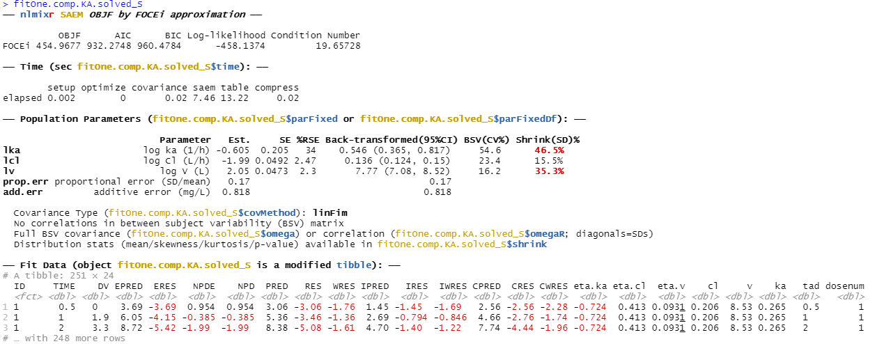
nlmixr² output for SAEM

Slide 42
The labels in the ini block end up in the output, and the log-transformed parameters are returned with a back-transformation and 95%CIs

Slide 43
Running nlmixr² models: save the object, and examine parameter trace plots when using SAEM to check convergence
## results are stored in the nlmixr object and can be viewed: fitOne.comp.KA.solved_S ## and saved for future use or reference: save(fitOne.comp.KA.solved_S, file = "fitOne.comp.KA.solved_S.Rdata") ## and for SAEM, convergence can be checked using a parameter trace plot: traceplot(fitOne.comp.KA.solved_S)

Slide 44
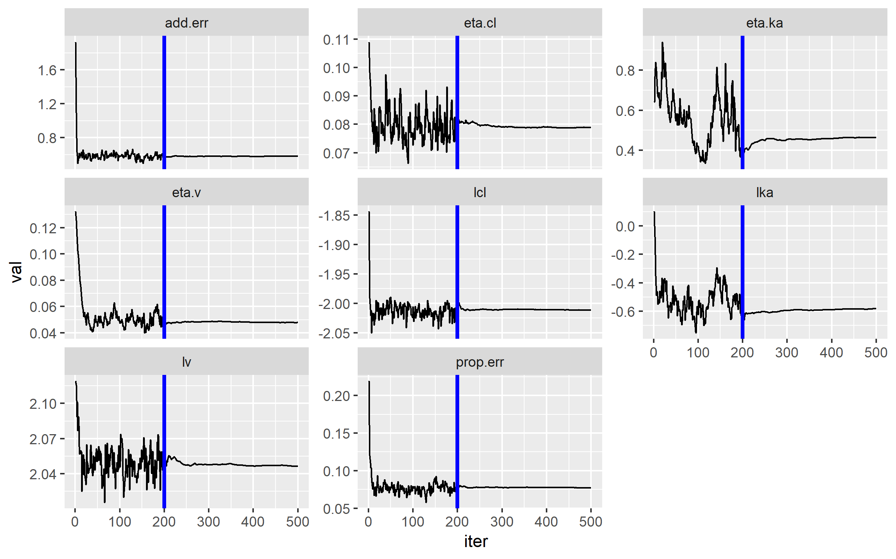
Traceplot for SAEM parameter estimates using traceplot command

Slide 45
nlmixr² is linked to ggPMX
# Model Diagnostics with ggPMX
# The controller is first constructed
ctr <- pmx_nlmixr(fitOne.comp.KA.solved_S,
conts = c("WT","AGE"),
cats=c("SEX","SPARSE"),
vpc=FALSE,
settings=pmx_settings(is.draft=FALSE))
# and can then be piped into a specific plot
# syntax for npde vs pred plot
ctr %>% pmx_plot_npde_pred
#alternatively:
pmx_plot_npde_pred(ctr)

Slide 46
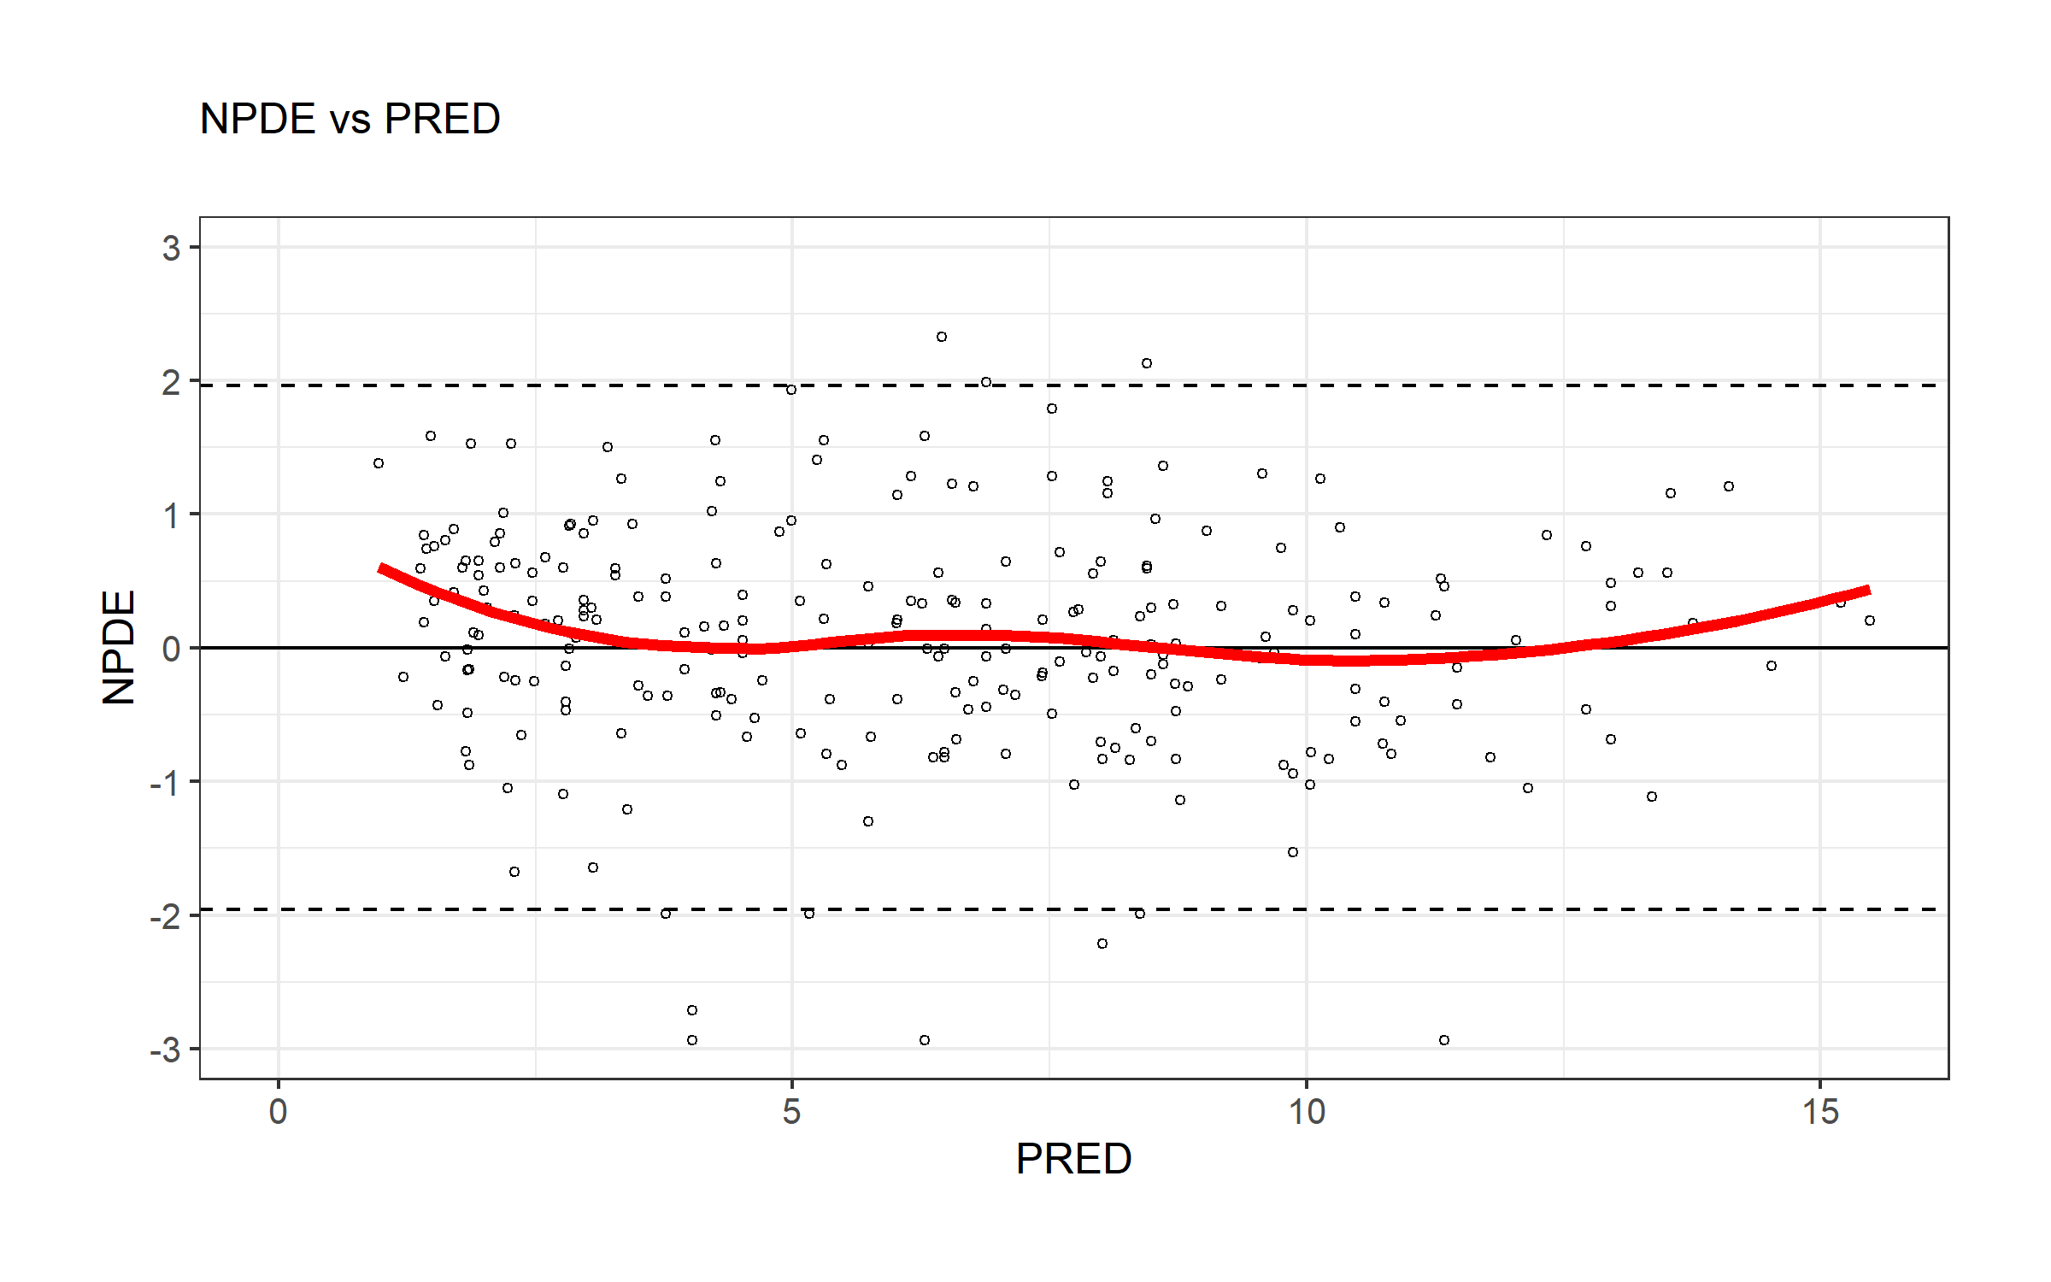
nlmixr² is linked to ggPMX
# Model Diagnostics with ggPMX
# The controller is first constructed
ctr <- pmx_nlmixr(fitOne.comp.KA.solved_S,
conts = c("WT","AGE"),
cats=c("SEX","SPARSE"),
vpc=FALSE,
settings=pmx_settings(is.draft=FALSE))
# and can then be piped into a specific plot
# syntax for npde vs pred plot
ctr %>% pmx_plot_npde_pred
#alternatively:
pmx_plot_npde_pred(ctr)

Slide 47
nlmixr² is linked to ggPMX
## Modify graphical options and add DRAFT label:
ctr %>% pmx_plot_npde_time(smooth = list(color="blue"),
point = list(shape=4),
s.draft=TRUE,
labels = list(x = "Time (hours)",
y = "Normalized PDE"))

Slide 48
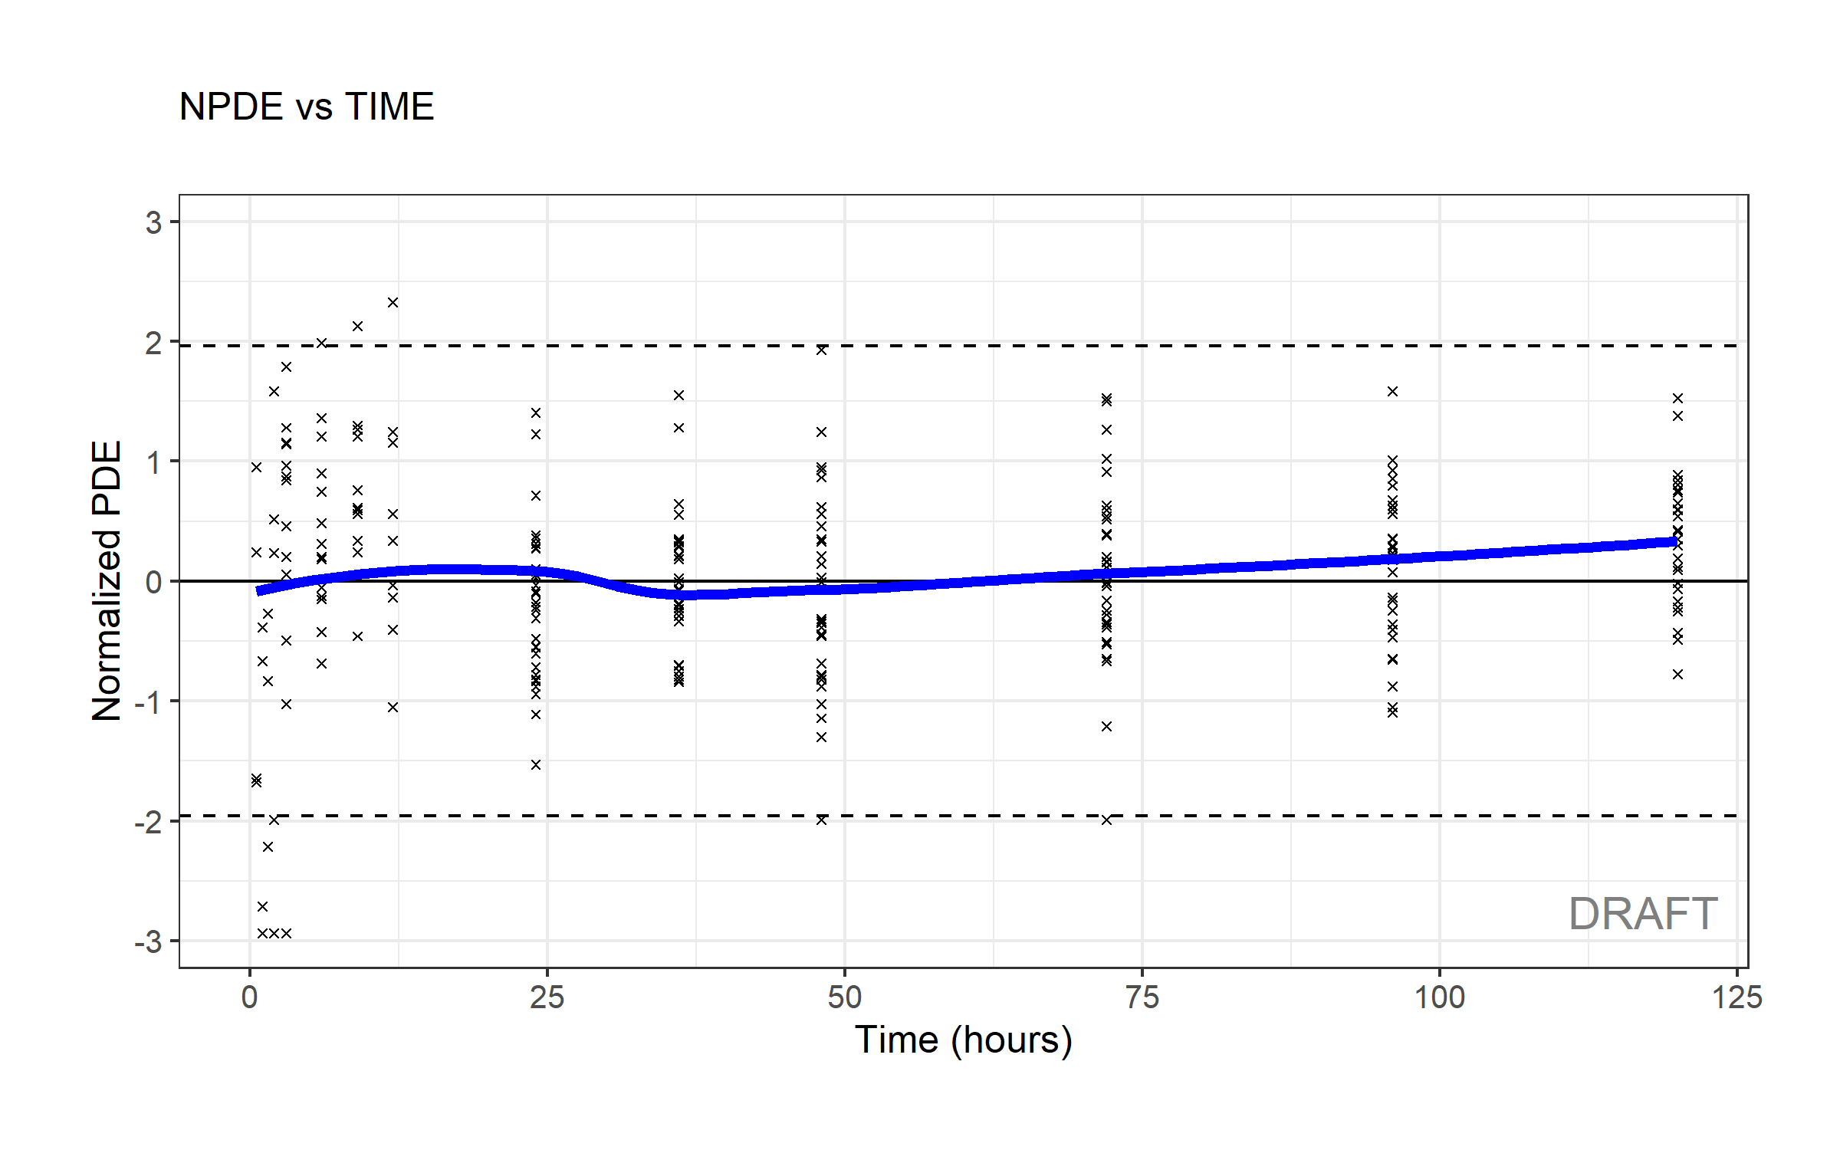
nlmixr² is linked to ggPMX
## Modify graphical options and add DRAFT label:
ctr %>% pmx_plot_npde_time(smooth = list(color="blue"),
point = list(shape=4),
s.draft=TRUE,
labels = list(x = "Time (hours)",
y = "Normalized PDE"))

Slide 49
nlmixr² is linked to ggPMX
## DV vs IPRED plot
ctr %>% pmx_plot_dv_ipred(scale_x_log10=TRUE, scale_y_log10=TRUE)
#You can filter to restrict the values of IPRED for instance:
ctr %>% pmx_plot_dv_ipred(scale_x_log10=TRUE, scale_y_log10=TRUE,filter=(IPRED>1))
## DV vs PRED plot
ctr %>% pmx_plot_dv_pred(scale_x_log10=TRUE, scale_y_log10=TRUE)
## Absolute individual weighted residuals to investigate the residual error model
ctr %>% pmx_plot_abs_iwres_ipred
#again, alternatively:
#pmx_plot_abs_iwres_ipred(ctr)
ctr %>% pmx_plot_iwres_dens
ctr %>% pmx_plot_eta_qq
ctr %>% pmx_plot_eta_box
ctr %>% pmx_plot_eta_hist
ctr %>% pmx_plot_eta_matrix

Slide 50
nlmixr² is linked to ggPMX
## generate a full report with diagnostics
ctr %>% pmx_report(name="ggPMX_report",
save_dir=".",
format="report",
extension="word")

Slide 51
nlmixr² is linked to Ben Guiastrennec's xpose* package that uses ggplot2
*https://uupharmacometrics.github.io/xpose/
## the nlmixr object can be transformed into an xpose object to allow diagnostics with the new xpose package ## the link between nlmixr and xpose is provided by the xpose.nlmixr package ## only xpose_data_nlmixr is from xpose.nlmixr
## all further commands (see cheatsheet) are from the xpose package
xpdb.1s <- xpose_data_nlmixr(fitOne.comp.KA.solved_S) ## this can also be used to generate trace plots (parameters vs iterations:) prm_vs_iteration(xpdb.1s) ## to remove the path to the script from the plot use: prm_vs_iteration(xpdb.1s,caption=NULL)

Slide 52
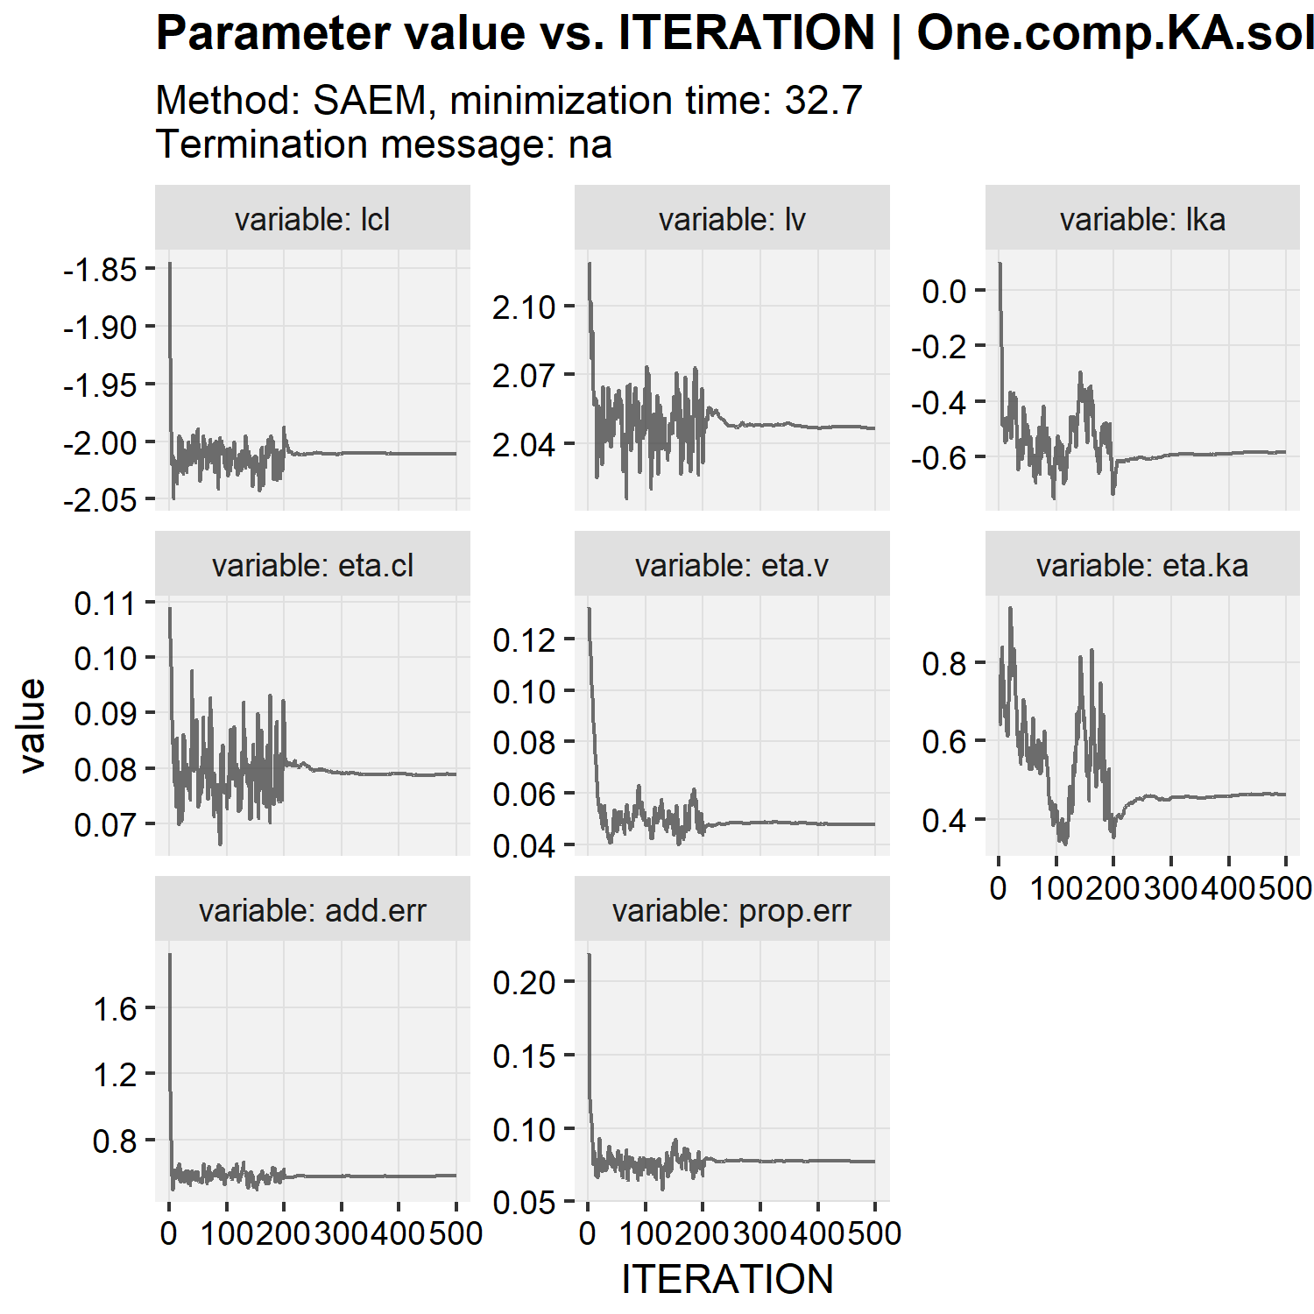
nlmixr² is linked to Ben Guiastrennec's xpose* package that uses ggplot2
*https://uupharmacometrics.github.io/xpose/
## the nlmixr object can be transformed into an xpose object to allow diagnostics with the new xpose package ## the link between nlmixr and xpose is provided by the xpose.nlmixr package ## only xpose_data_nlmixr is from xpose.nlmixr
## all further commands (see cheatsheet) are from the xpose package
xpdb.1s <- xpose_data_nlmixr(fitOne.comp.KA.solved_S) ## this can also be used to generate trace plots (parameters vs iterations:) prm_vs_iteration(xpdb.1s) ## to remove the path to the script from the plot use: prm_vs_iteration(xpdb.1s,caption=NULL)

Slide 53
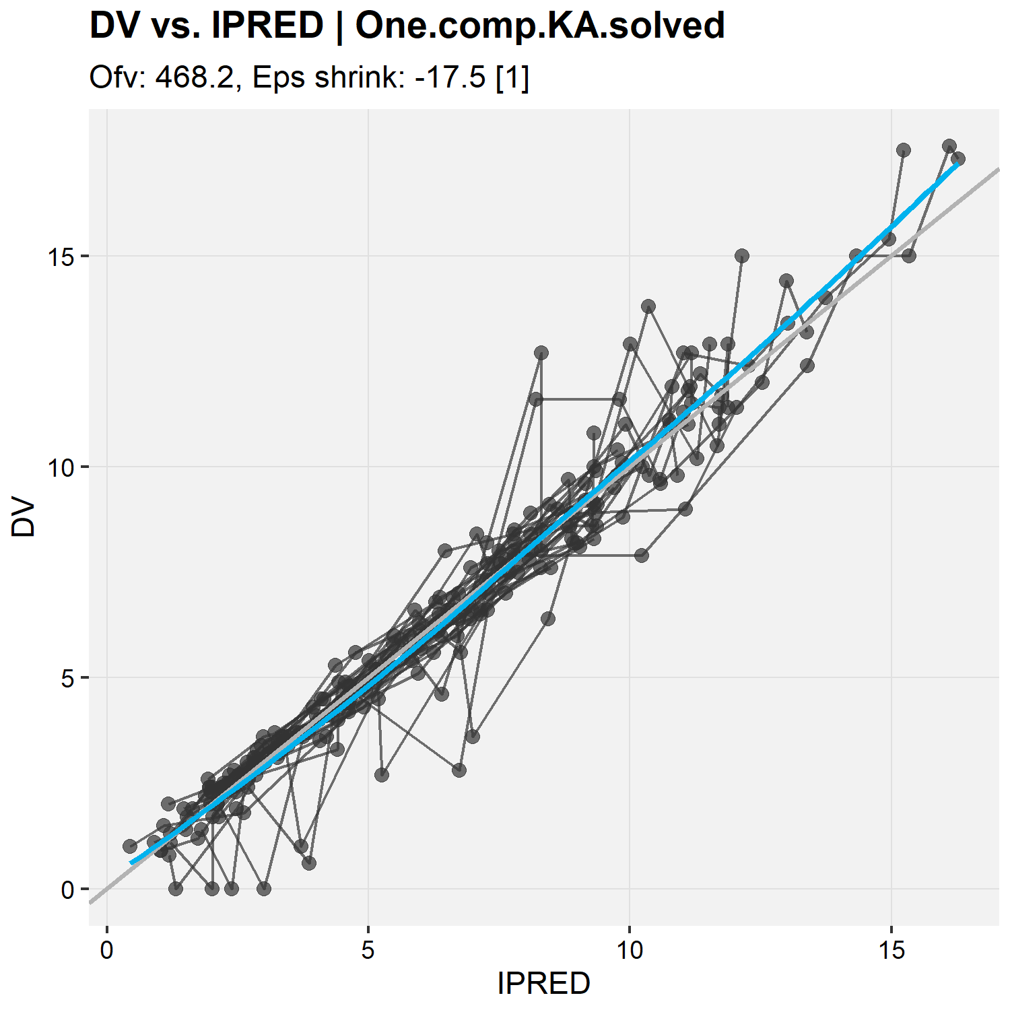
DV vs IPRED using xpose
xpdb.1s <- xpose_data_nlmixr(fitOne.comp.KA.solved_F) ## dv vs ipred plot: dv_vs_ipred(xpdb.1s, caption = NULL)

Slide 54
nlmixr² is linked to Ron Keizer's vpc* package
*http://vpc.ronkeizer.com/
## nlmixr comes with its own built-in vpc functionality that uses Ron Keizer's vpc package ## see the cheatsheet for further options
## because the data set uses nominal time points, it is nice to have the bins surround these time points ## so that each time point falls in a bin
bin_mids <- sort(unique(PKdata$TIME))
bin_edges <- bin_mids - c(0, diff(bin_mids) / 2) vpcPlot( fitOne.comp.KA.solved_S, #the nlmixr object n = 500, #number of trials simulated
bins = bin_edges, show = list(obs_dv = TRUE, #additional items to show, like the observations
obs_median = TRUE,
sim_median = TRUE,
sim_median_ci = TRUE,
obs_ci = TRUE,
pi = TRUE
), xlab = "Time (h)", #x-axis label ylab = "Concentration (mg/L)", #y-axis label title = "VPC for first order absorption PopPK model" )

Slide 55
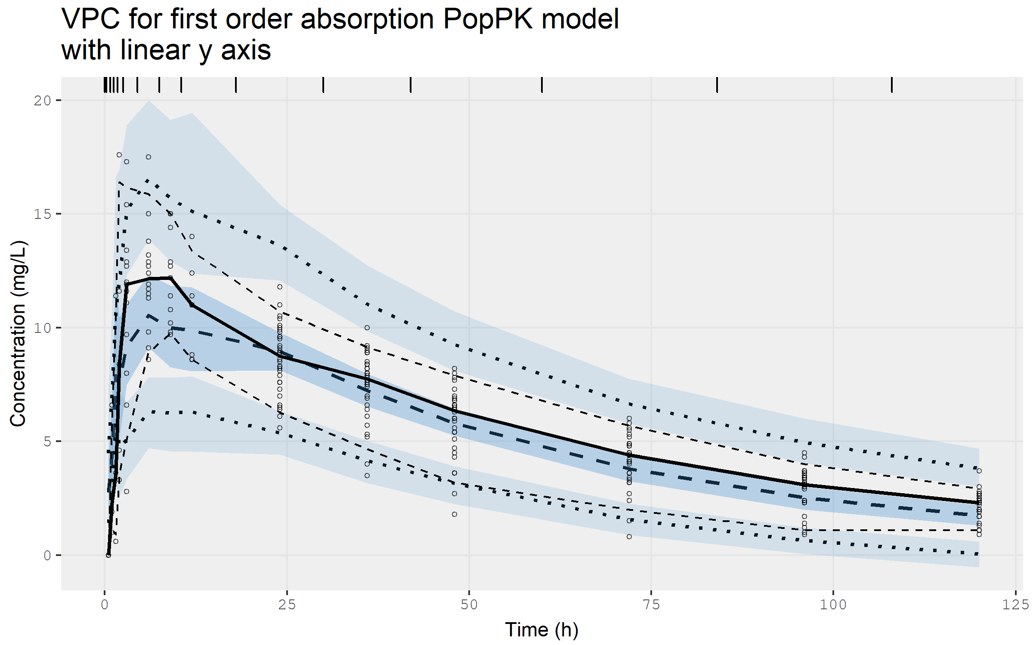
VPC for the base model on linear scale...

Slide 56
...and on log scale
## or with a log y-axis starting at 0.5 vpcPlot( fitOne.comp.KA.solved_S, #the nlmixr object n = 500, #number of trials simulated
bins = bin_edges, show = list(obs_dv = TRUE, #additional items to show, like the observations
obs_median = TRUE,
sim_median = TRUE,
sim_median_ci = TRUE,
obs_ci = TRUE,
pi = TRUE
), xlab = "Time (h)", #x-axis label ylab = "Concentration (mg/L)", #y-axis label title = "VPC for first order absorption PopPK model"
log_y = TRUE, #to request a log y-axis log_y_min = 0.5 #starting at 0.5 )

Slide 57
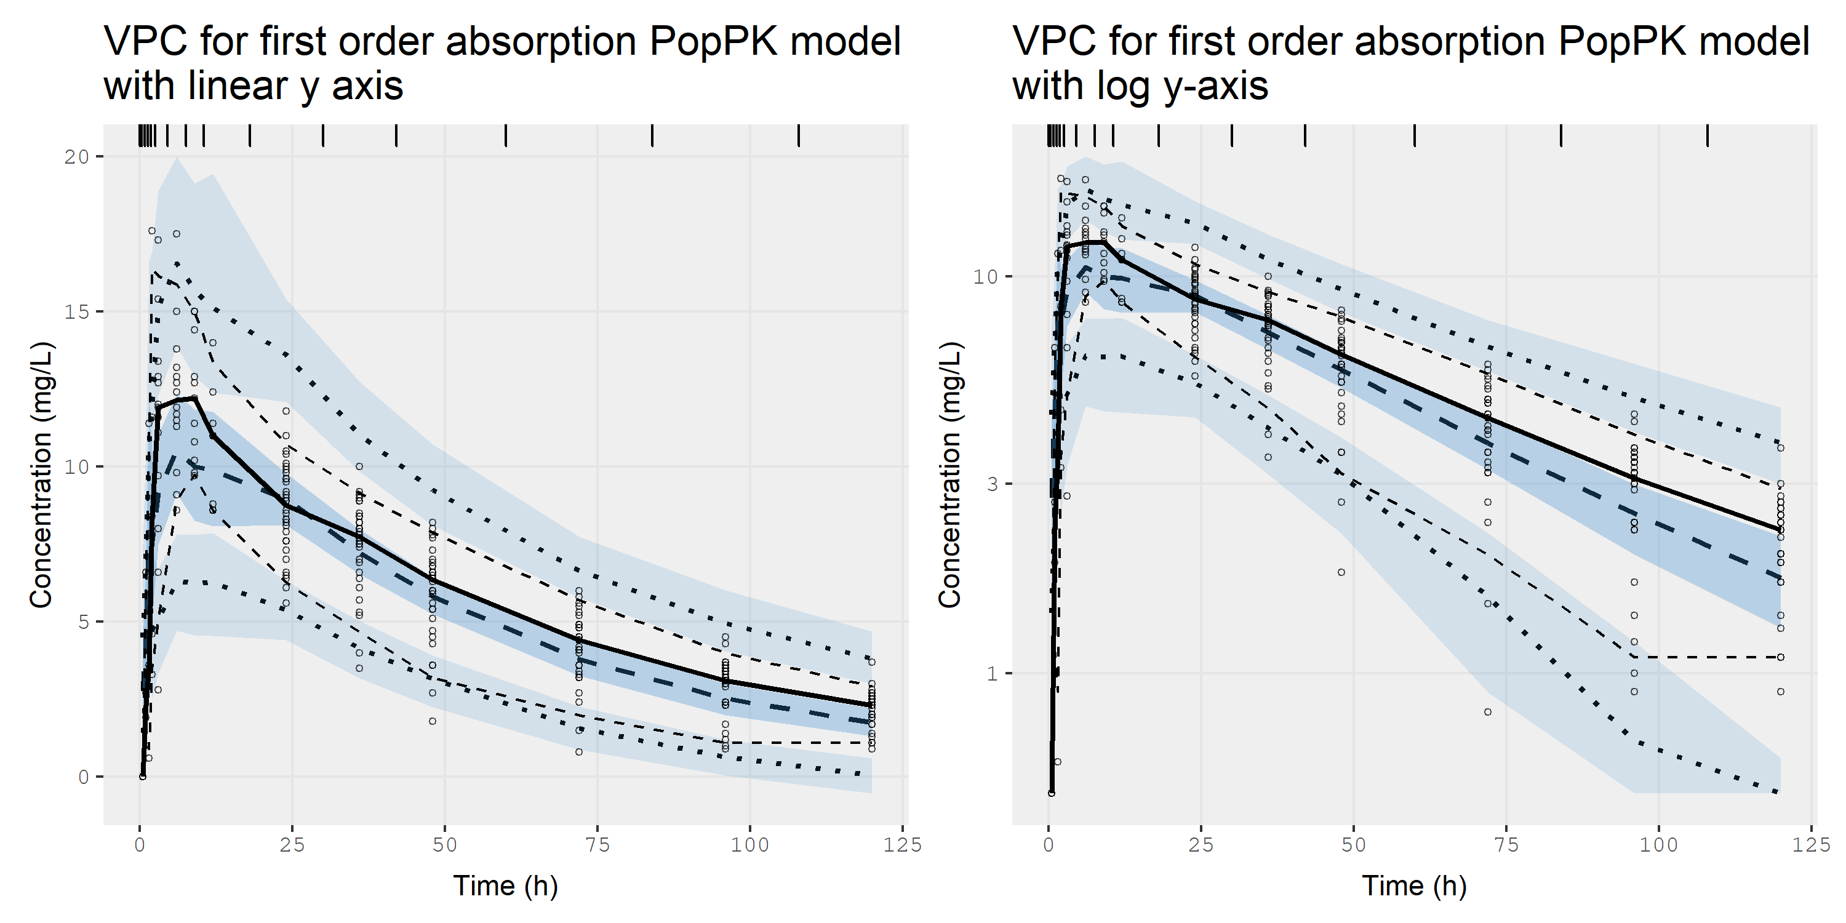
...and on log scale. It's super fast ☺

Slide 58
nlmixr² can generate individual graphs using augPred
## Individual fits can be generated using augPred (augmented predictions) ## that provides smooth profiles by interpolating the predictions between observations: plot(augPred(fitOne.comp.KA.solved_S)) ## ...use the arrows in the plot window to examine the earlier curves

Slide 59
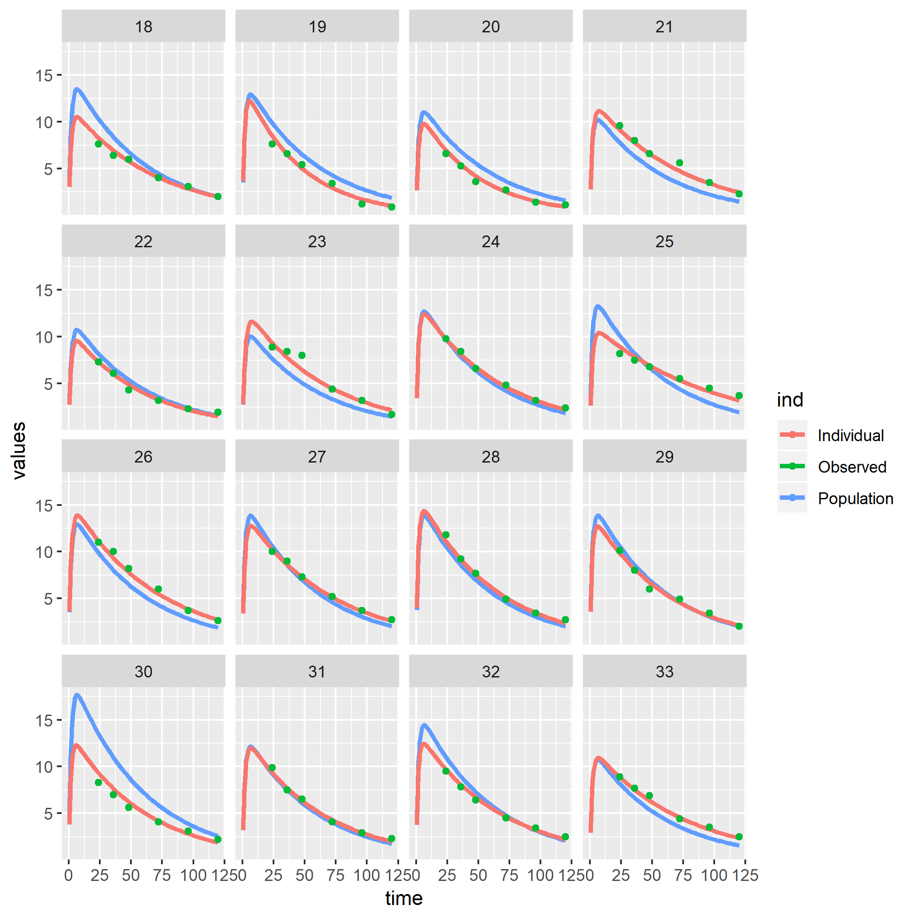
nlmixr² can generate individual graphs using augPred
## Individual fits can be generated using augPred (augmented predictions) ## that provides smooth profiles by interpolating the predictions between observations: plot(augPred(fitOne.comp.KA.solved_S)) ## ...use the arrows in the plot window to examine the earlier curves

Slide 60
use augPred output to plot using your favourite package…
#or the augPred output can be plotted to your liking, for instance using ggplot2 or the lattice function xyplot: indivpk<-augPred(fitOne.comp.KA.solved_S) nlmixCOLS <- c("#28466A","#8DB6CD","#B40000) ## specify array of colours for curves xyplot( values~time|id, ## plot the variable values by time and make a separate panel for each id data=indivpk, ## data source with smooth interpolated predictions and observations groups=ind, ## make separate curves by ind that separates Observed data,
## Individual predictions and Population predictions layout=c(8,4), ## arrange as 8 columns and 4 rows type=c("l","l","p"), ## represent these three by a line, a line and only markers (l=line, p=points) col=nlmixCOLS[c(2,1,3)], ## colours for each curve cex=c(0.1,0.1,1), ## character size for the markers lwd=c(2,2,0.1), ## line width of the lines pch=19, ## use closed circles as marker xlab="Time (hr)\n", ## x-axis label ylab="Warfarin (mg/L)", ## y-axis label as.table=TRUE, ## have the first plot at the top left (otherwise plot 1 starts at the lower left corner) scales=list(alternating=1), ## have axis labels at left and bottom (and not alternating) main="First order-absorption linear elimination", ## title for plot auto.key=list(adj=1,col=nlmixCOLS[c(2,1,3)],columns=3,space="bottom",rectangles=FALSE,points=FALSE) ## key for curves )

Slide 61
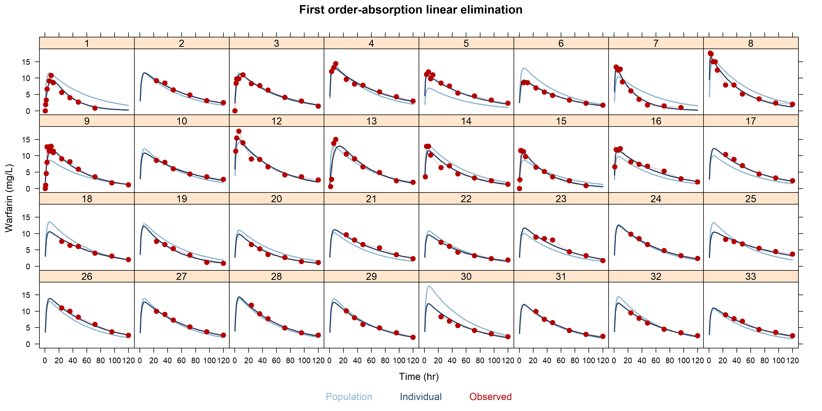
..like lattice

Slide 62
Hands-on session II: running nlmixr² and diagnostics
Examine the code in PopSim_2.R to run a pre-programmed FOCEi analysis with a solved system and its diagnostics
Stop at nlmixr analysis Part 2

Slide 63
Solved systems and ODEs…
Using solved-system code:
For a solved system, model structure is automatically derived (!) from the parameter names in the ini block
Using ODEs:
ODEs are much more flexible but also more run-time consuming
linCmt() ~ prop(prop.err) + add(add.err)
# RxODE-style differential equation definition d/dt(gut) = -ka * gut d/dt(central) = ka * gut - (cl / v) * central ## Concentration is calculated cp = central / v # And is assumed to follow proportional and additive error cp ~ prop(prop.err) + add(add.err)

Slide 64
Running nlmixr² for a system of ODEs using FOCEI
One.comp.KA.ODE <- function() { ini({ # Where initial conditions/variables are specified lka <- log(1.15) #log ka (/h) lcl <- log(0.135) #log Cl (L/hr) lv <- log(8) #log V (L) prop.err <- 0.15 #proportional error (SD/mean) add.err <- 0.6 #additive error (mg/L) eta.ka ~ 0.5 eta.cl ~ 0.1 eta.v ~ 0.1 }) model({ # Where the model is specified cl <- exp(lcl + eta.cl) v <- exp(lv + eta.v) ka <- exp(lka + eta.ka) # RxODE-style differential equation definition d/dt(gut) = -ka * gut d/dt(center) = ka * gut - (cl / v) * center ## Concentration is calculated cp = center / v ## And is assumed to follow proportional and additive error cp ~ prop(prop.err) + add(add.err) }) } fitOne.comp.KA.ODE_F <- nlmixr(One.comp.KA.ODE, PKdata, est = "focei")

Slide 65
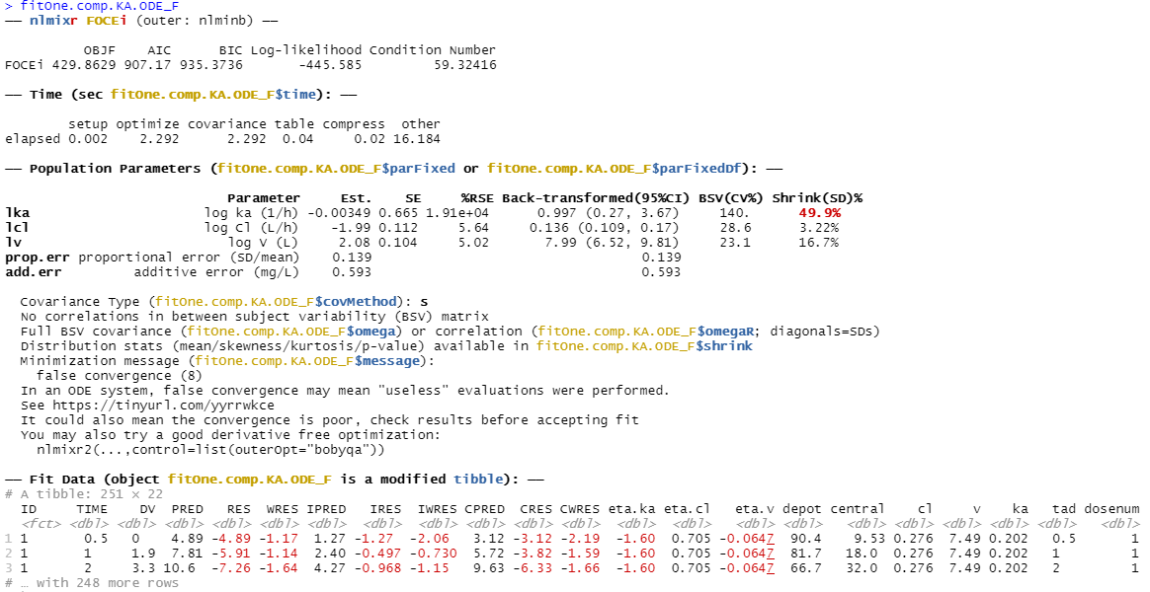
nlmixr² output for FOCEI with ODEs

Slide 66
Hands-on session III: running nlmixr² with ODEs and perform model development
Start at nlmixr analysis Part 2
Examine the code in PopSim_2.R to run a pre-programmed FOCEi analysis with ODEs
Examine the goodness of fit plots and implement alternative models for absorption (like one or more transit compartments…)

Slide 67
Running nlmixr²: 1 transit compartment
## 5 transit compartments One.comp.transit <- function() { ini({ # Where initial conditions/variables are specified lktr <- log(1.15) #log transit rate constant (/h) lcl <- log(0.135) #log Cl (L/h) lv <- log(8) #log V (L) prop.err <- 0.15 #proportional error (SD/mean) add.err <- 0.6 #additive error (mg/L) eta.ktr ~ 0.5 eta.cl ~ 0.1 eta.v ~ 0.1 }) model({ # Where the model is specified ktr <- exp(lktr + eta.ktr) cl <- exp(lcl + eta.cl) v <- exp(lv + eta.v) ## ODE example d/dt(depot) =-ktr*depot d/dt(central) = ktr*trans – (cl/v)*central d/dt(trans) = ktr*(depot - trans) ## where residual error is assumed to follow proportional and additive error central ~ prop(prop.err) + add(add.err) })}

Slide 68
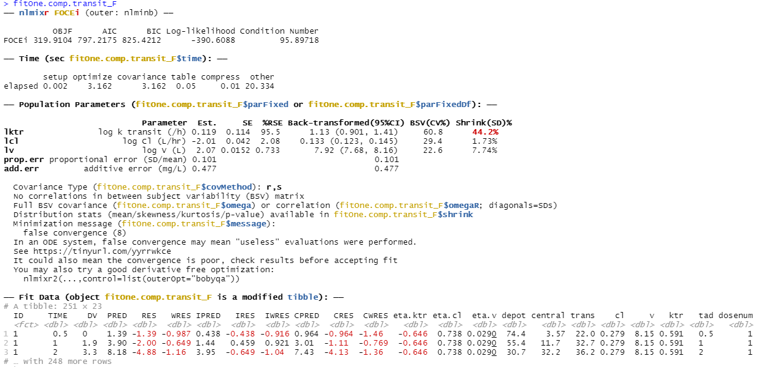
nlmixr² output: 1 transit compartment with ODEs using FOCEI

Slide 69
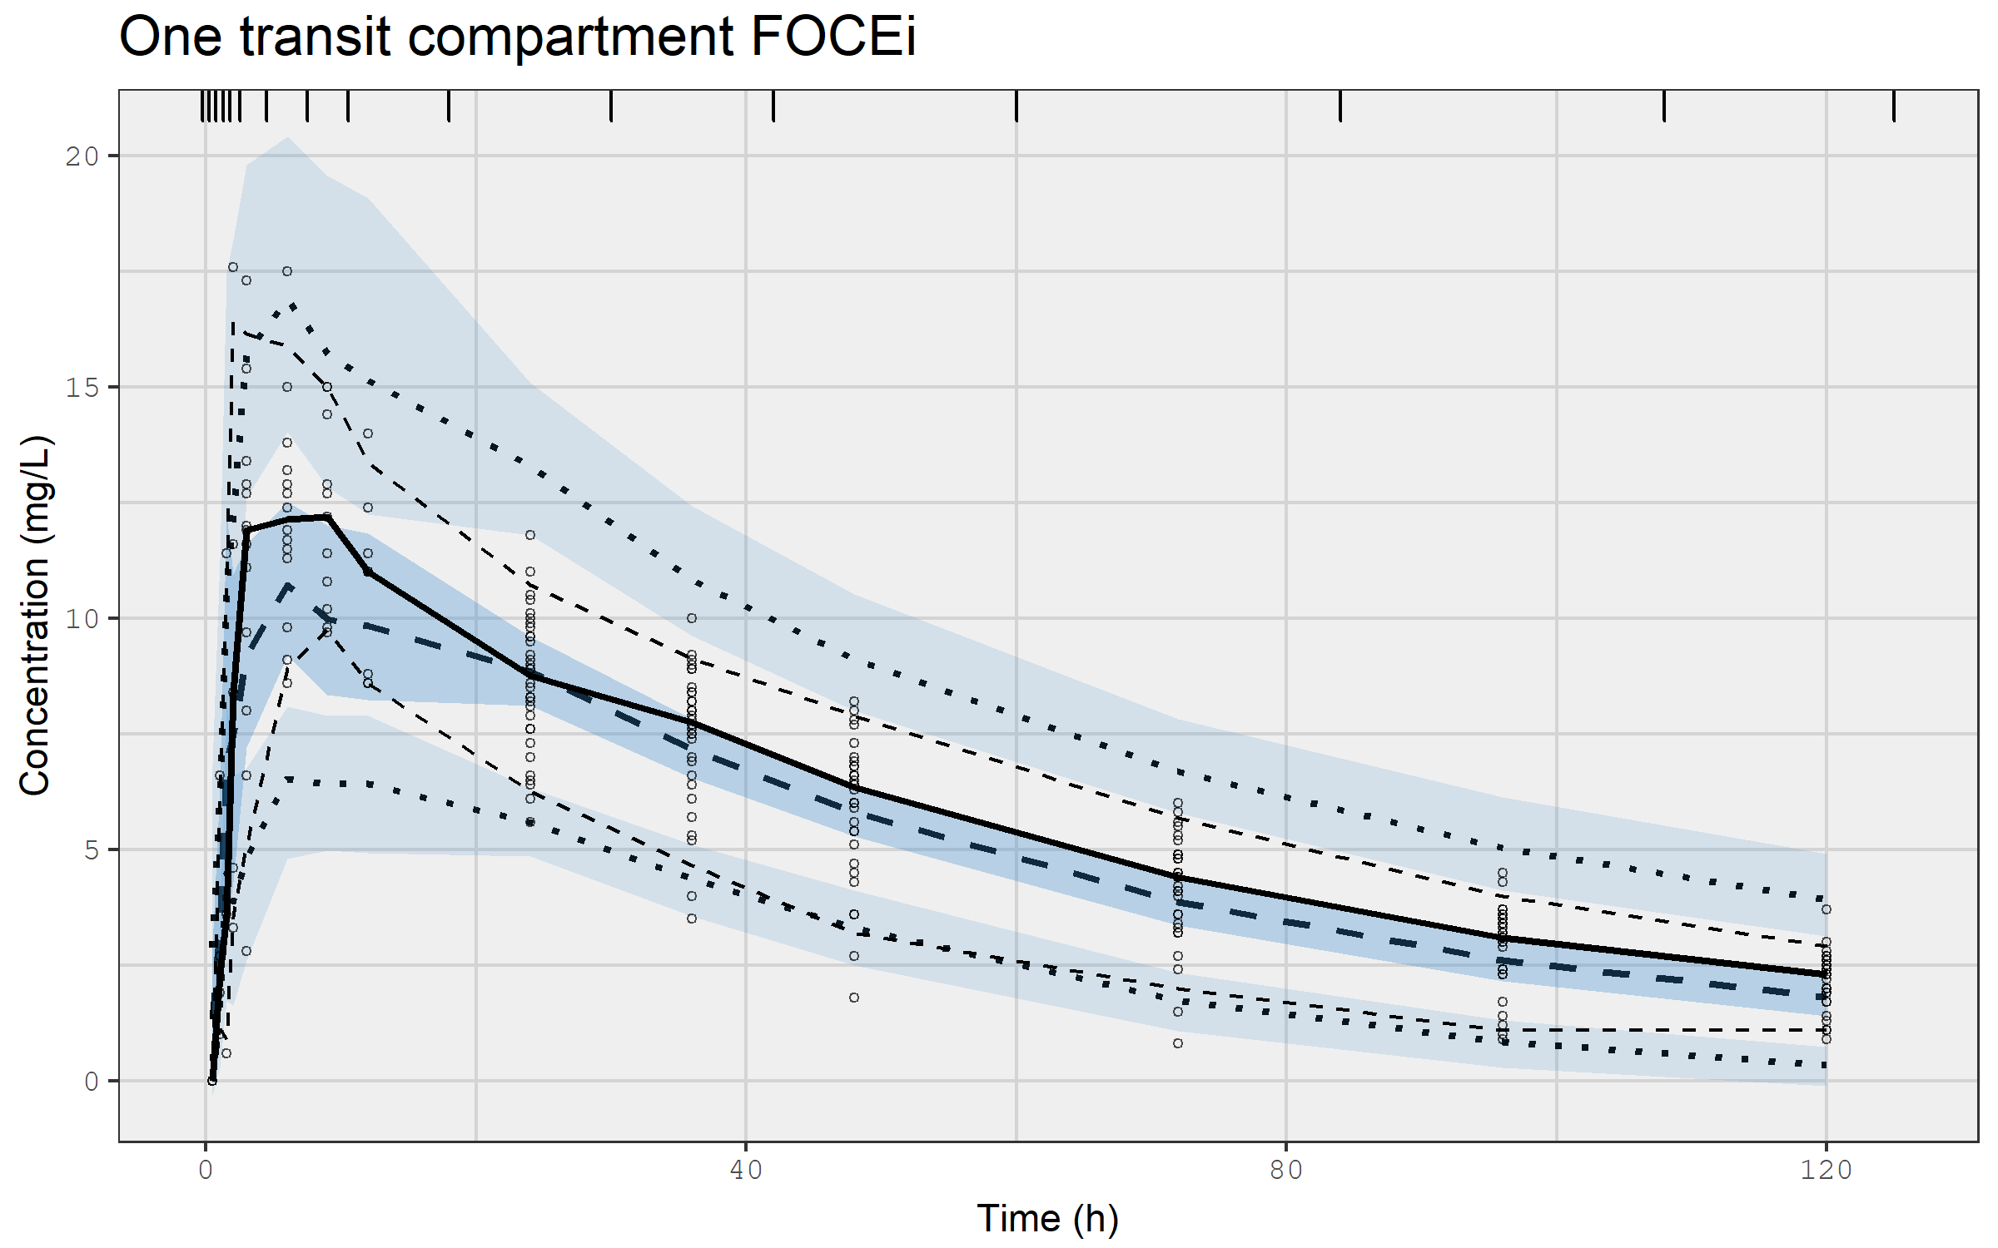
VPC for one compartment model with a transit compartment using FOCEI

Slide 70
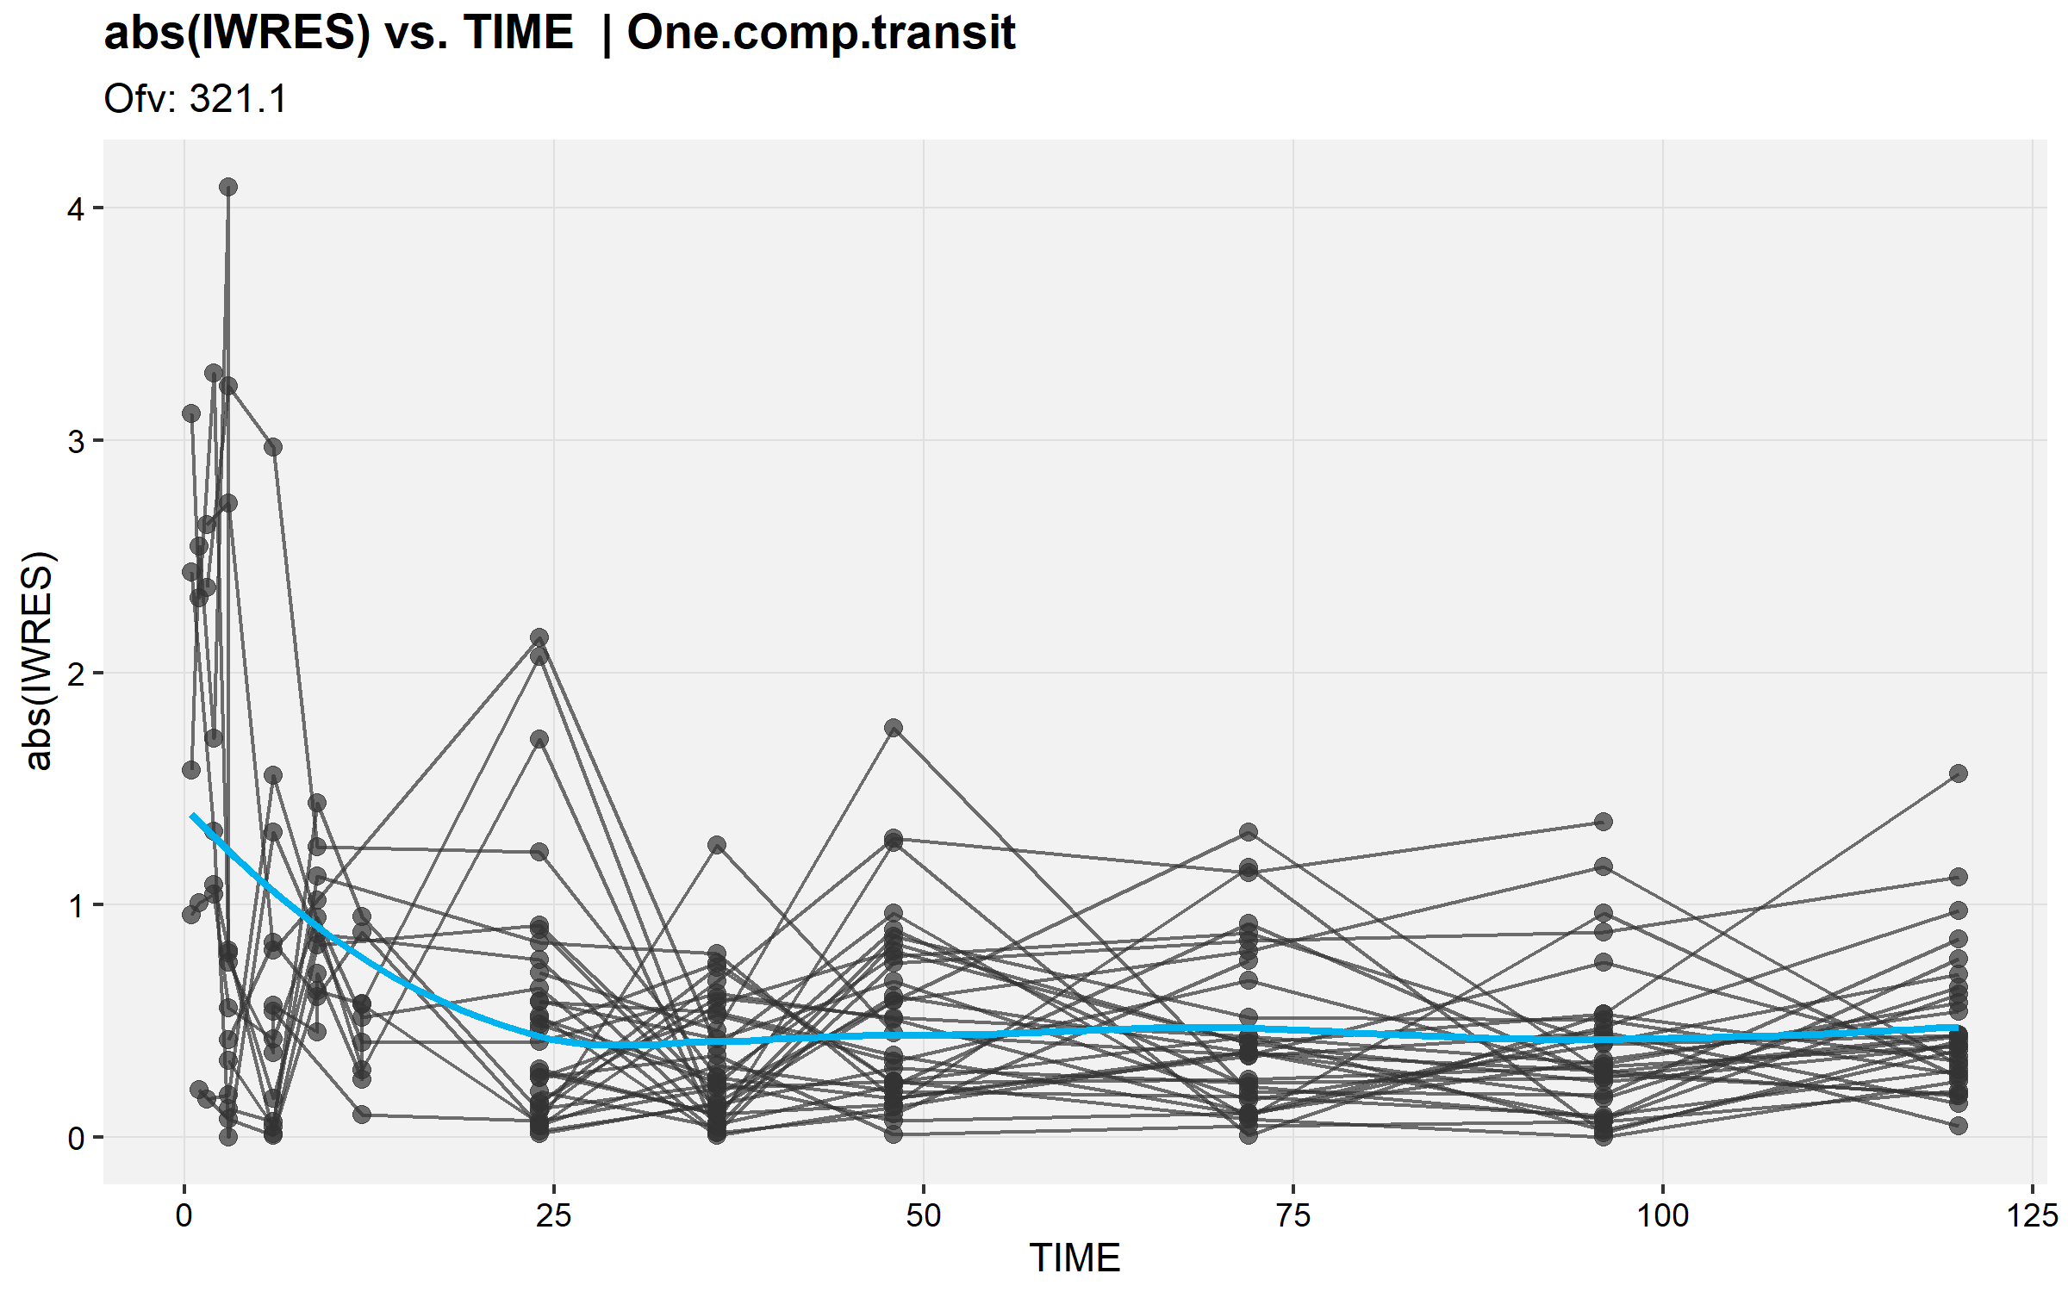
|IWRES| by time for first order absorption model with 1 transit compartment using FOCEi

Slide 71
Running nlmixr²: 5 transit compartments
## 5 transit compartments KA1tr5ode <- function() { ini({ # Where initial conditions/variables are specified lktr <- log(1.15) #log transit rate constant (/h) lcl <- log(0.135) #log Cl (L/h) lv <- log(8) #log V (L) prop.err <- 0.15 #proportional error (SD/mean) add.err <- 0.6 #additive error (mg/L) eta.ktr ~ 0.5 #IIV ktr eta.cl ~ 0.1 #IIV cl eta.v ~ 0.1 #IIV v }) model({ # Where the model is specified ktr <- exp(lktr + eta.ktr) cl <- exp(lcl + eta.cl) v <- exp(lv + eta.v) ## ODE example d/dt(depot) =-ktr*depot d/dt(central) = ktr*transit5 - cl* central/v d/dt(transit1)= ktr*(depot - transit1) d/dt(transit2)= ktr*(transit1 - transit2) d/dt(transit3)= ktr*(transit2 - transit3) d/dt(transit4)= ktr*(transit3 - transit4) d/dt(transit5)= ktr*(transit4 - transit5) ## where residual error is assumed to follow proportional and additive error central ~ prop(prop.err) + add(add.err) })}

Slide 72
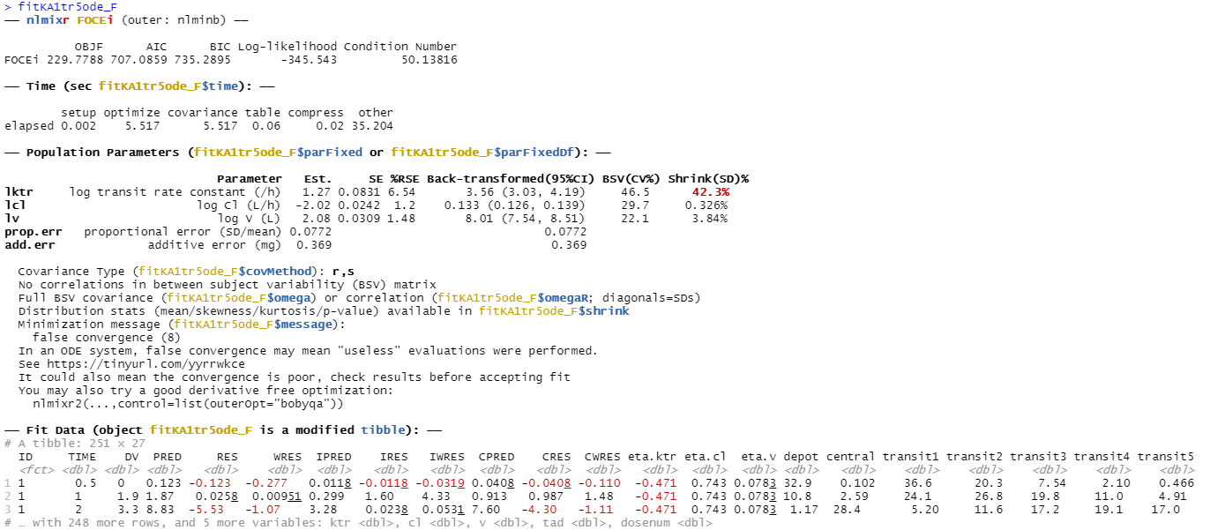
nlmixr2 output: 5 transit compartments with ODEs using FOCEi

Slide 73
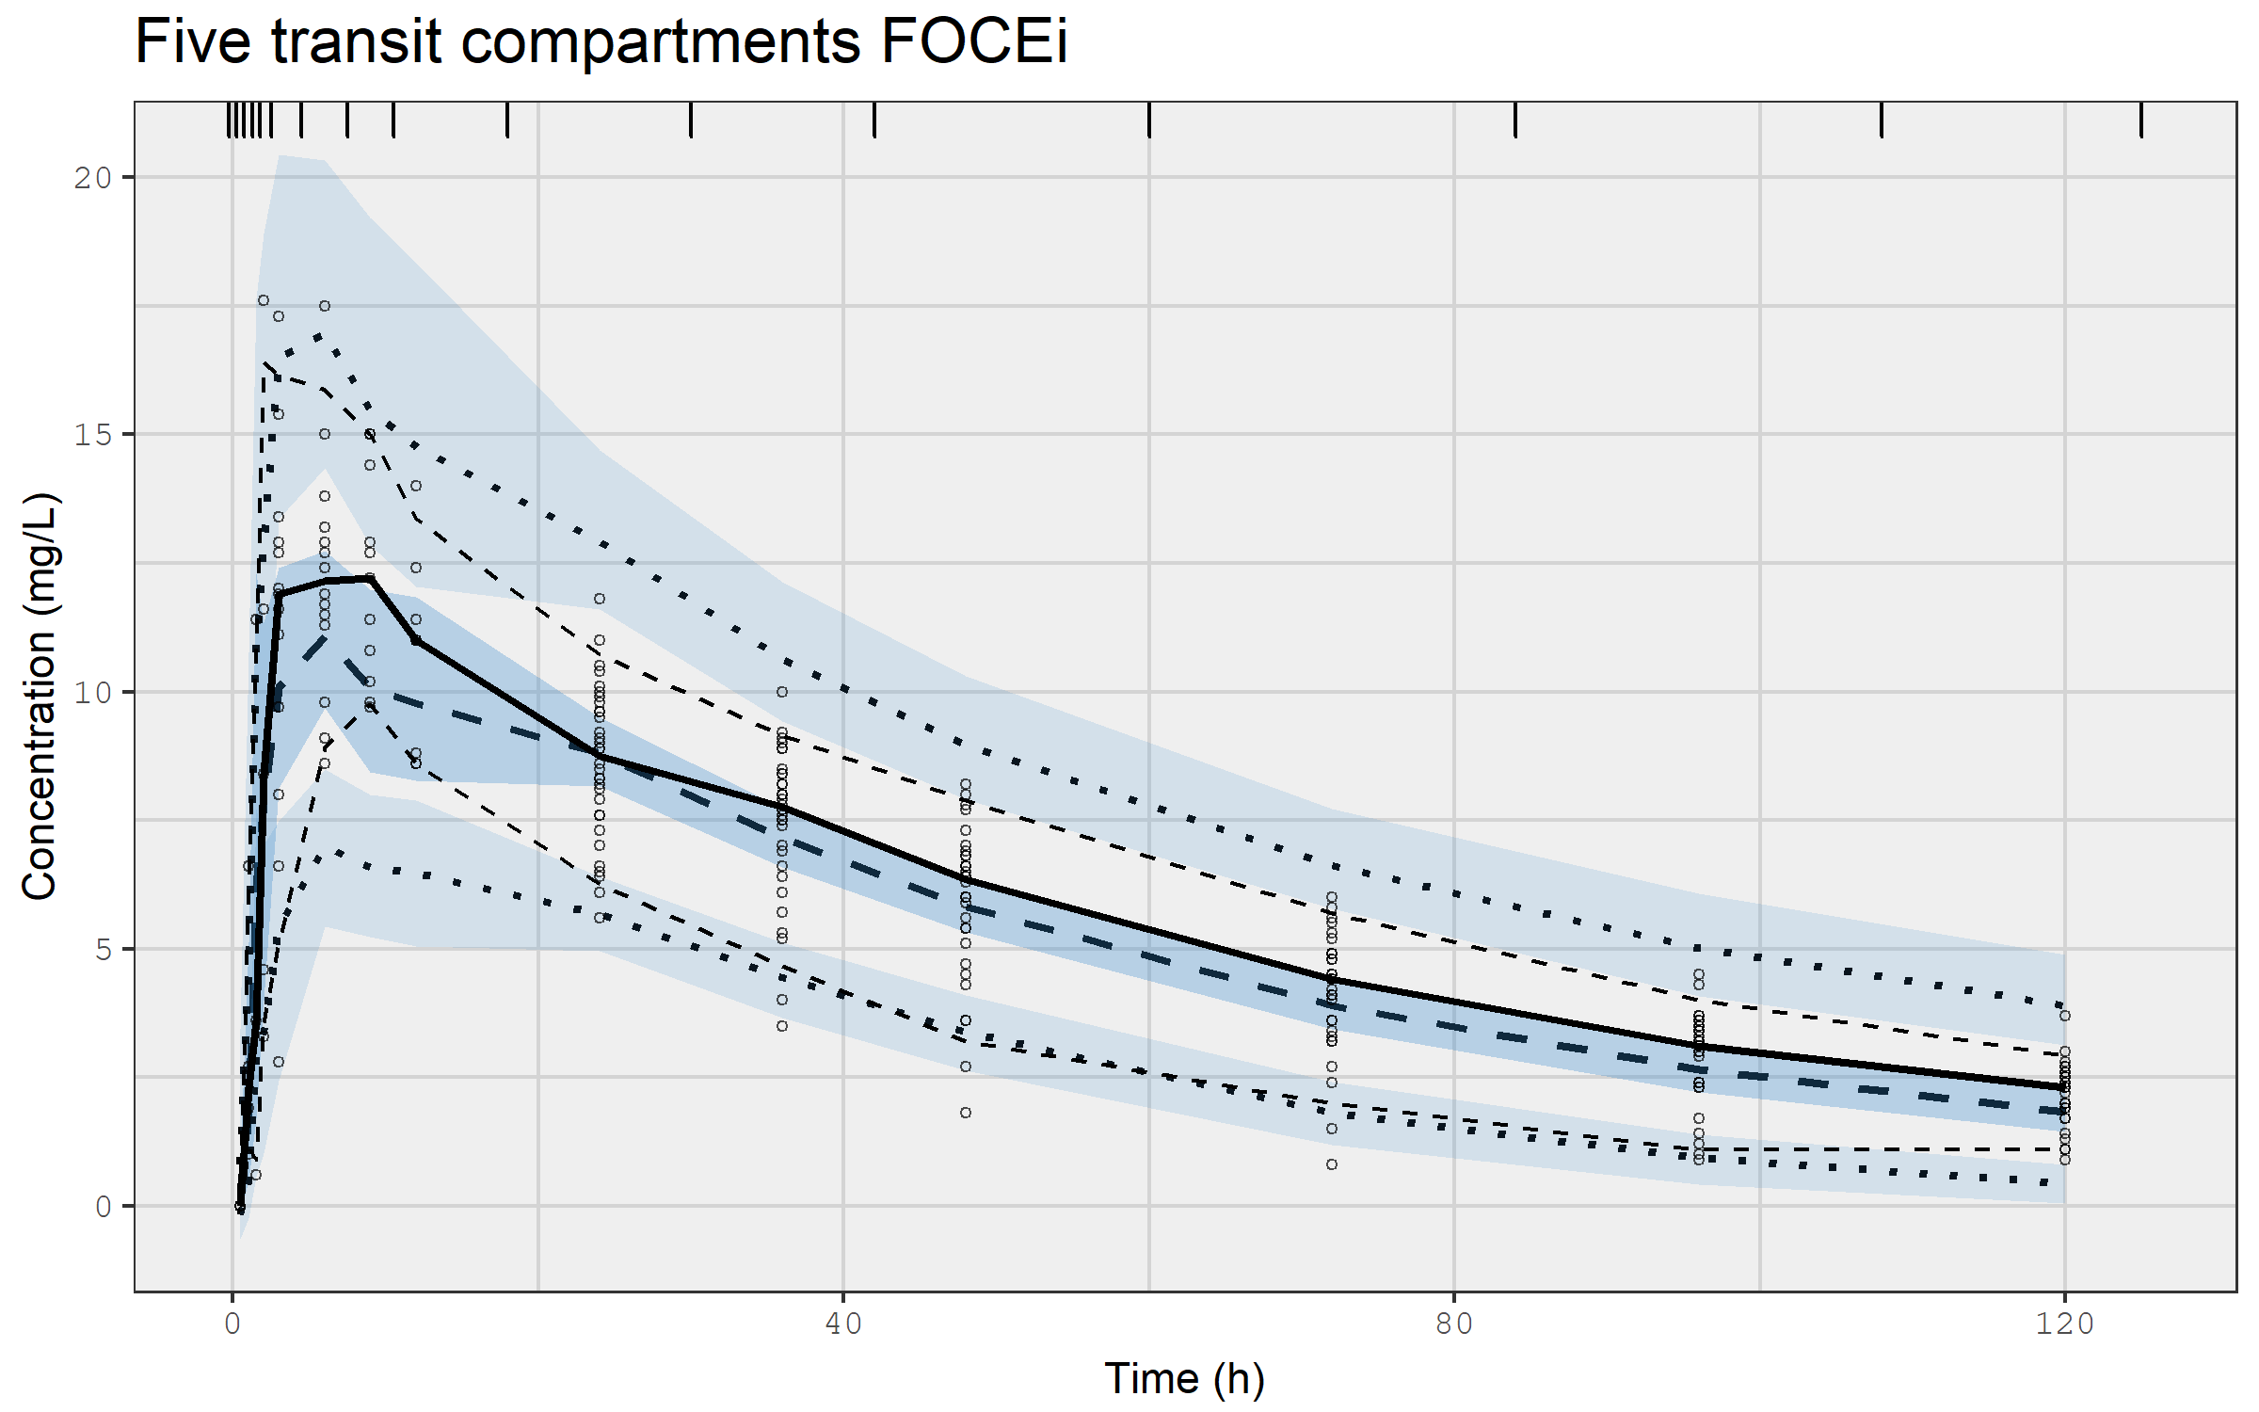
VPC for first order absorption with 5 transit compartments using FOCEi

Slide 74
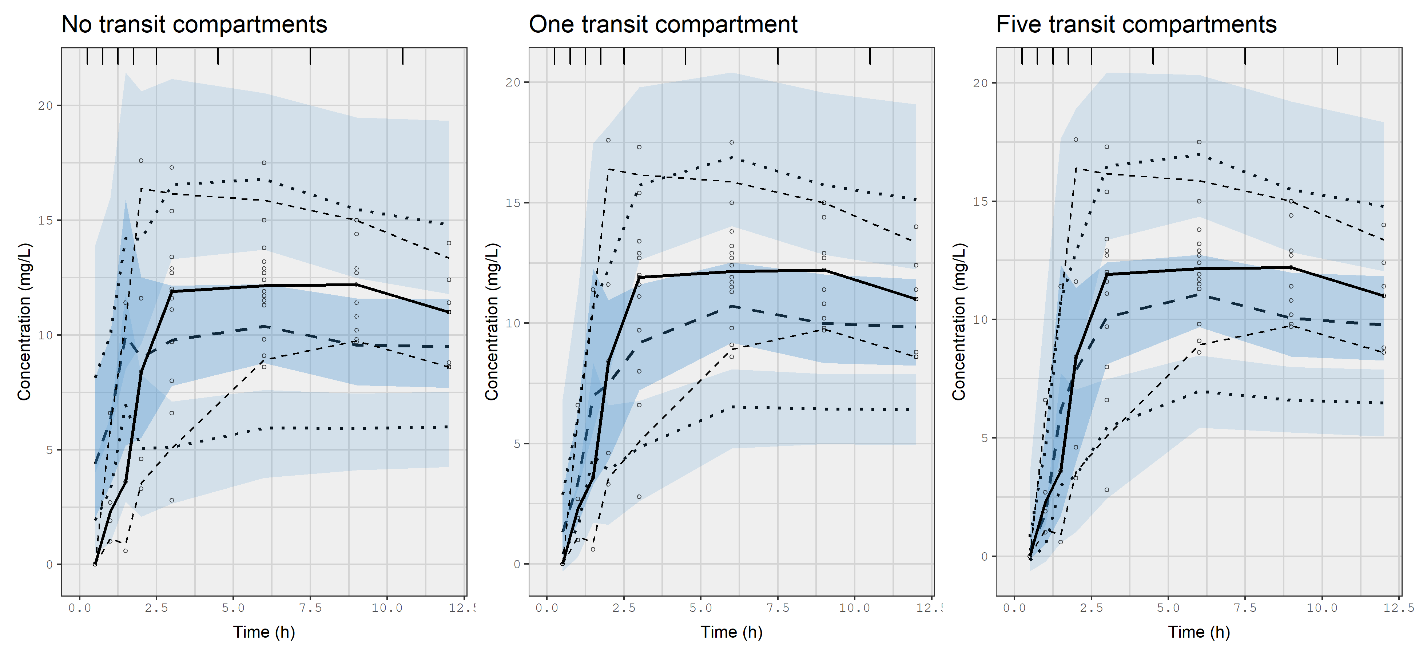
Comparing the VPCs for the first 12 hours to see if absorption is described better using zero, one, or five transit compartments

Slide 75
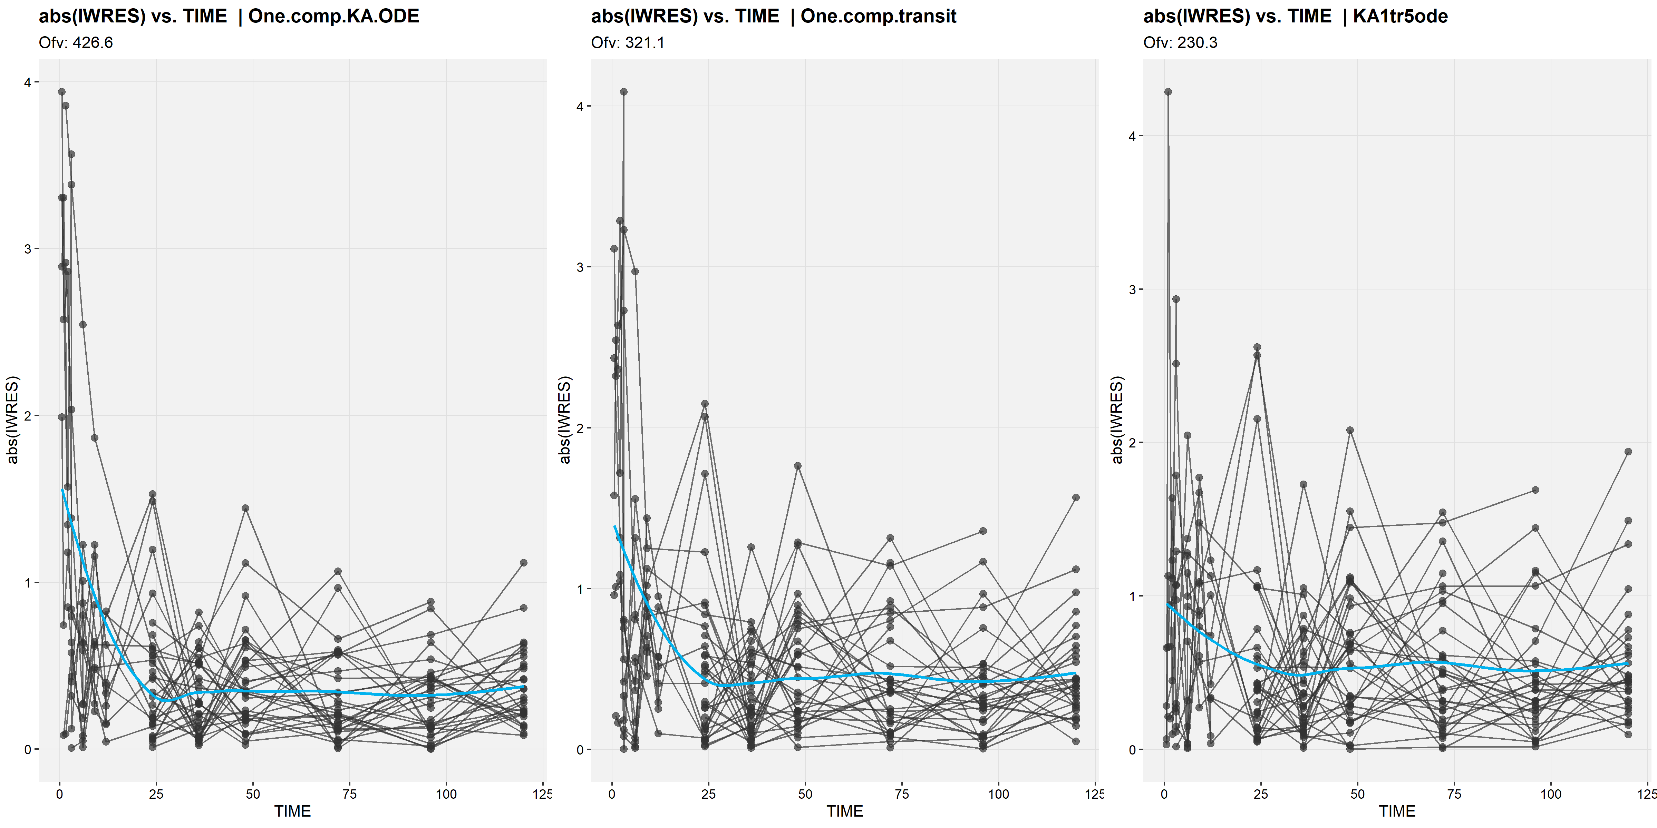
Comparison of |IWRESI| plots for different absorption models No transit compartment (left), one transit compartment (middle), 5 transit compartments (right)

Slide 76
nlmixr² can read in NONMEM output and create nlmixr² models to simulate and re-estimate using nonmem2rx and babelmixr2

Slide 77
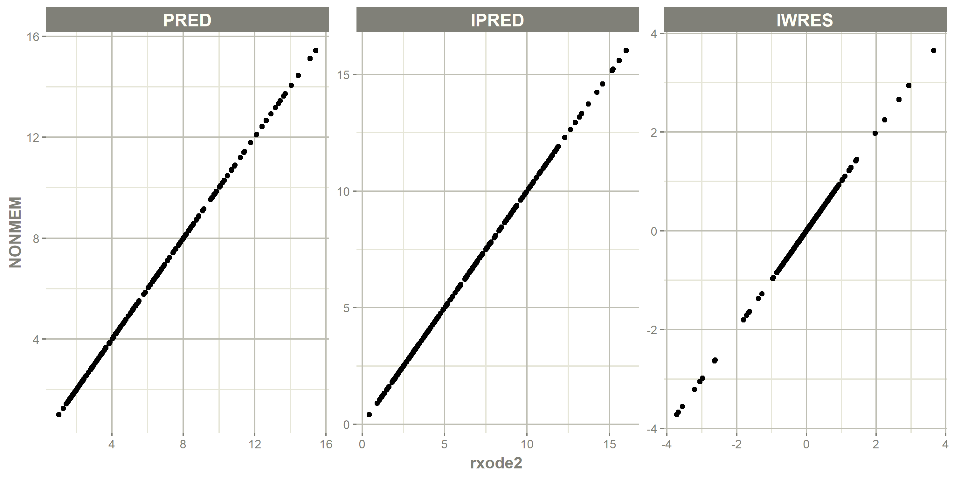
Check to see if the NONMEM-generated PRED, IPRED and IWRES values match the values when the model is used to simulate using rxode2

Slide 78
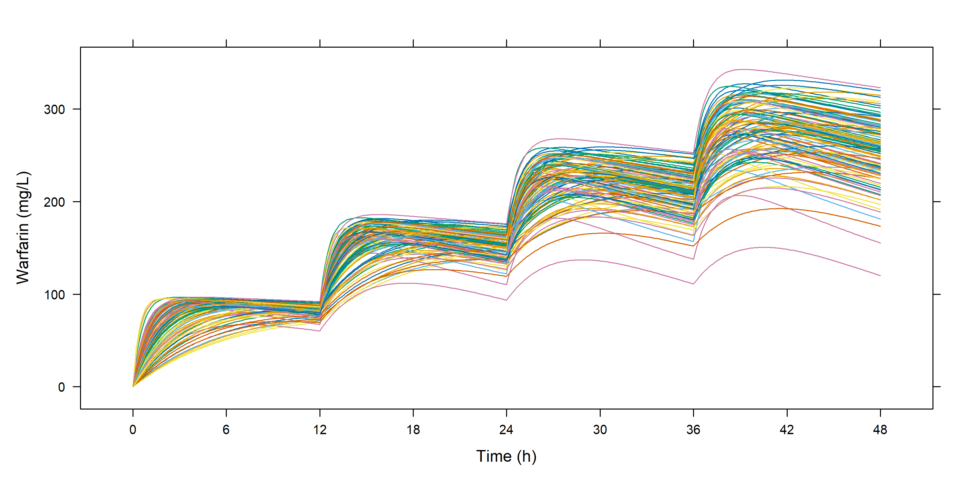
The rxode2 object can be used to simulate new regimens: four doses 12 hours apart of 100 mg using 100 subjects

Slide 79
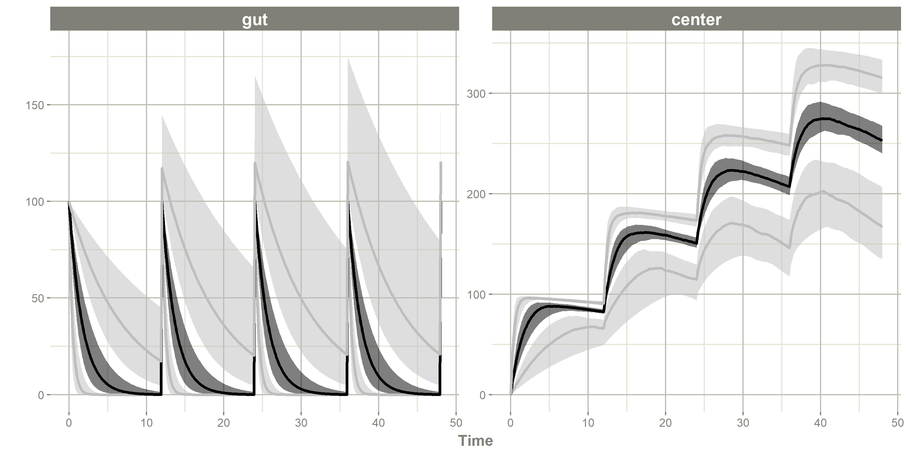
Or simulate 100 studies with these NONMEM parameters to capture uncertainty in theta estimates

Slide 80
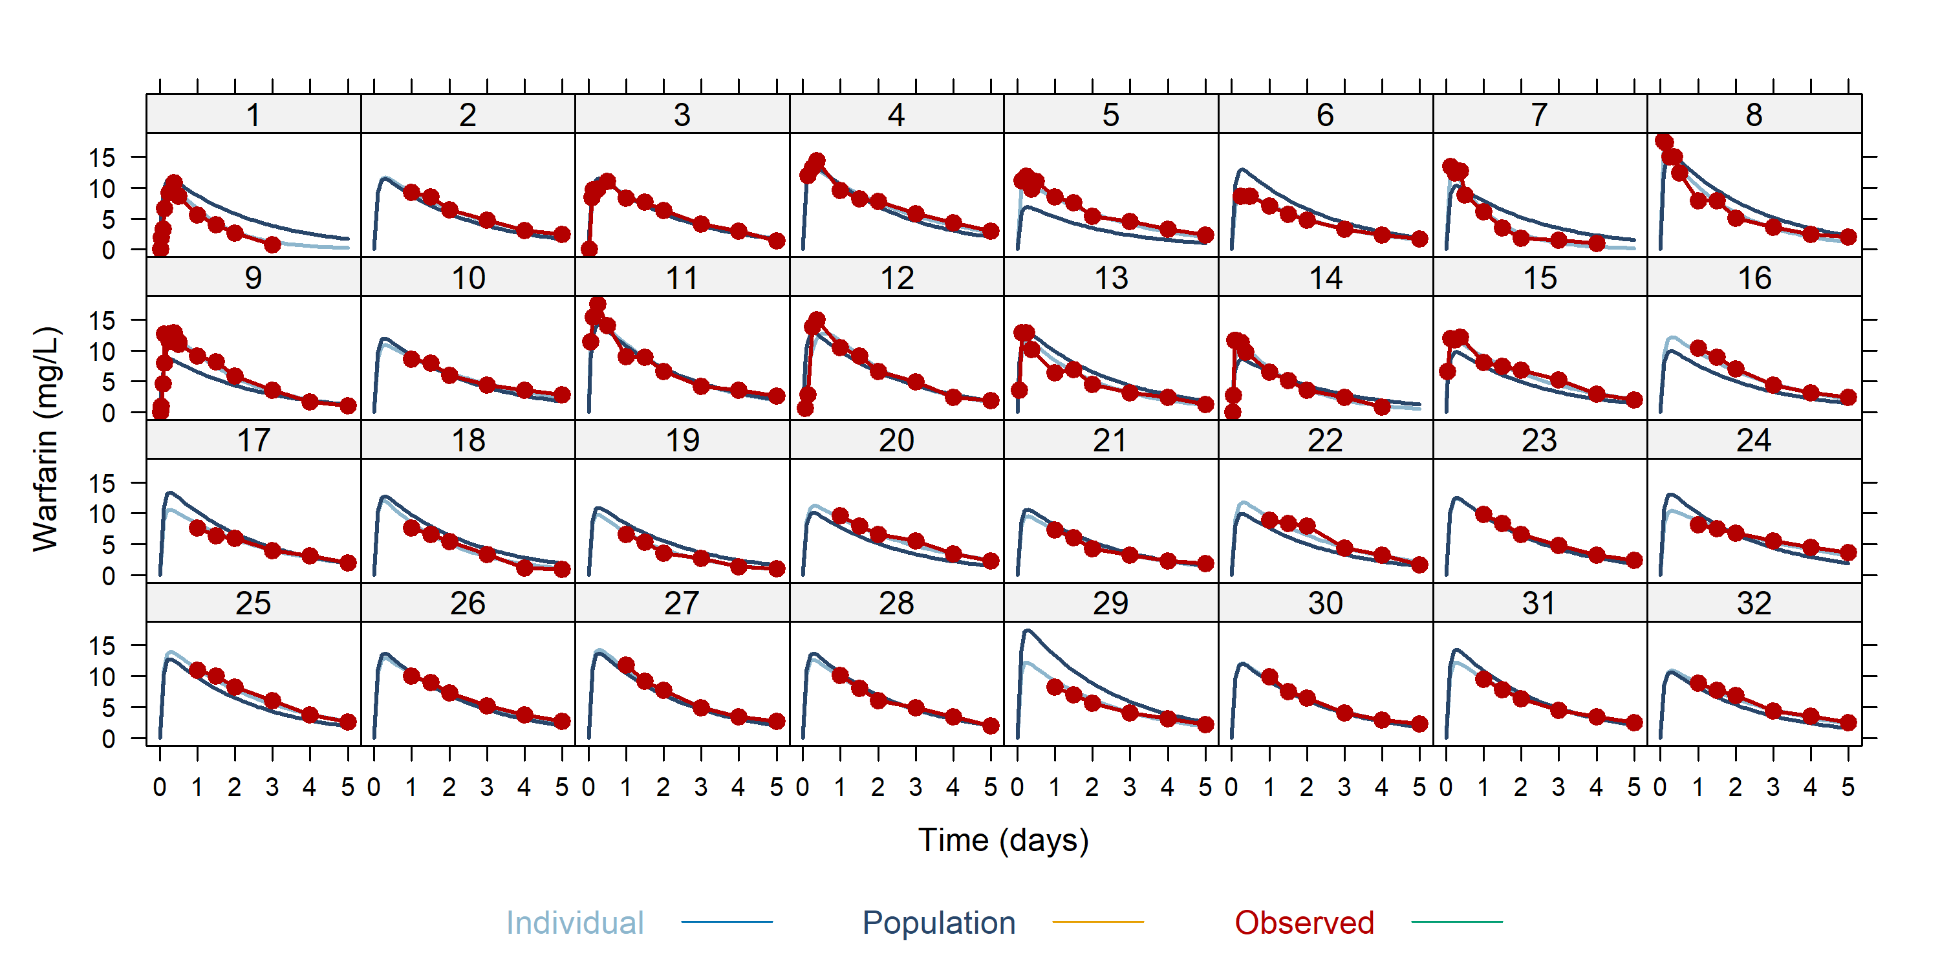
The rxode2 object can be translated to an nlmixr2 object to create individual plots for instance

Slide 81
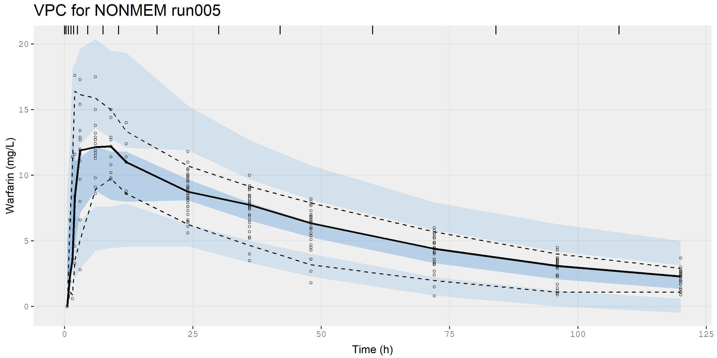
The rxode2 object can be translated to an nlmixr2 object to create VPCs

Slide 82
nlmixr² can generate empirical Bayes estimates for Bayesian feedback: individual EBEs for a new data set using existing population parameters
KA1tr5posthoc <- function() { ini({ # Specify previously obtained population estimates (e.g. from NONMEM or nlmixr) lktr <- 1.18994619 #log ktr (/h) lcl <- -2.01737477 #log Cl (L/h) lv <- 2.06631620 #log V (L) prop.err <- 0.07883633 #proportional error (SD/mean) add.err <- 0.37249666 #additive error (mg/L) eta.ktr ~ 0.2532964 eta.cl ~ 0.08073339 eta.v ~ 0.04490733 }) model({ cl <- exp(lcl + eta.cl) v <- exp(lv + eta.v) ktr <- exp(lktr + eta.ktr) d/dt(trns1) = -ktr * trns1 d/dt(trns2) = ktr * trns1 - ktr * trns2 d/dt(trns3) = ktr * trns2 - ktr * trns3 d/dt(trns4) = ktr * trns3 - ktr * trns4 d/dt(trns5) = ktr * trns4 - ktr * trns5 d/dt(central) = ktr * trns5 - (cl/v) * central cp = central/v cp ~ prop(prop.err) + add(add.err) }) } fitKA1tr5_Fph <- nlmixr(KA1tr5posthoc, PKdata,
est = "posthoc") # Specify posthoc as estimation method
Useful in a therapeutic drug monitoring setting
Or for generating exposure estimates with a particularly nasty model that you do not want to refit on new data ☺

Slide 83
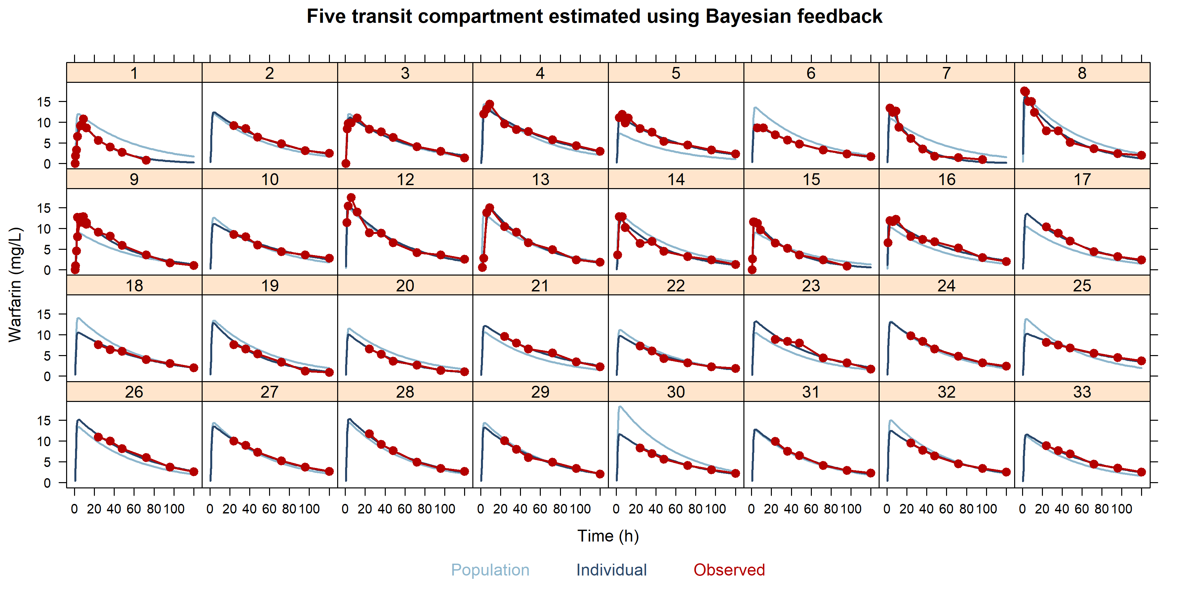
Individual graphs for the five transit compartment model estimated using Bayesian feedback; perfect fit even though there was no actual parameter estimation

Slide 84
Parameterisation and mu-referencing
For SAEM, parameters must be defined using 'mu-referencing’
This means that inter-individual variability parameters must be added onto population parameters
This implies estimating log-parameters with the IIV added on the log-scale
For FOCEi, mu-referencing is not strictly required, but is shown to provide superior estimation results
For a binary covariate (e.g. sex 0/1), the back-transformed estimate is a fold-change that can be re-written as a percentage change

Slide 85
Corresponding nlmixr² code
## One compartment transit model with Sex on V KAtr1_sexV <- function() { ini({ lktr <- log(1.15) #log k transit (/h) lcl <- log(0.135) #log CL (L/h) lv <- log(8) #log V (L) Sex_V <- 0.1 #log Sex on v prop.err <- 0.15 #proportional error (SD/mean) add.err <- 0.6 #additive error (mg/L) eta.ktr ~ 0.5 eta.cl ~ 0.1 eta.v ~ 0.1 }) model({ #Sex on volume cl <- exp(lcl + eta.cl) v <- exp(lv + eta.v + Sex_V * SEX) #the SEX covariate is 0 or 1 in the data set ktr <- exp(lktr + eta.ktr) d/dt(depot) = -ktr * depot d/dt(central) = ktr * trans - (cl/v) * central d/dt(trans) = ktr * depot - ktr * trans cp = central/v cp ~ prop(prop.err) + add(add.err) })

Slide 86
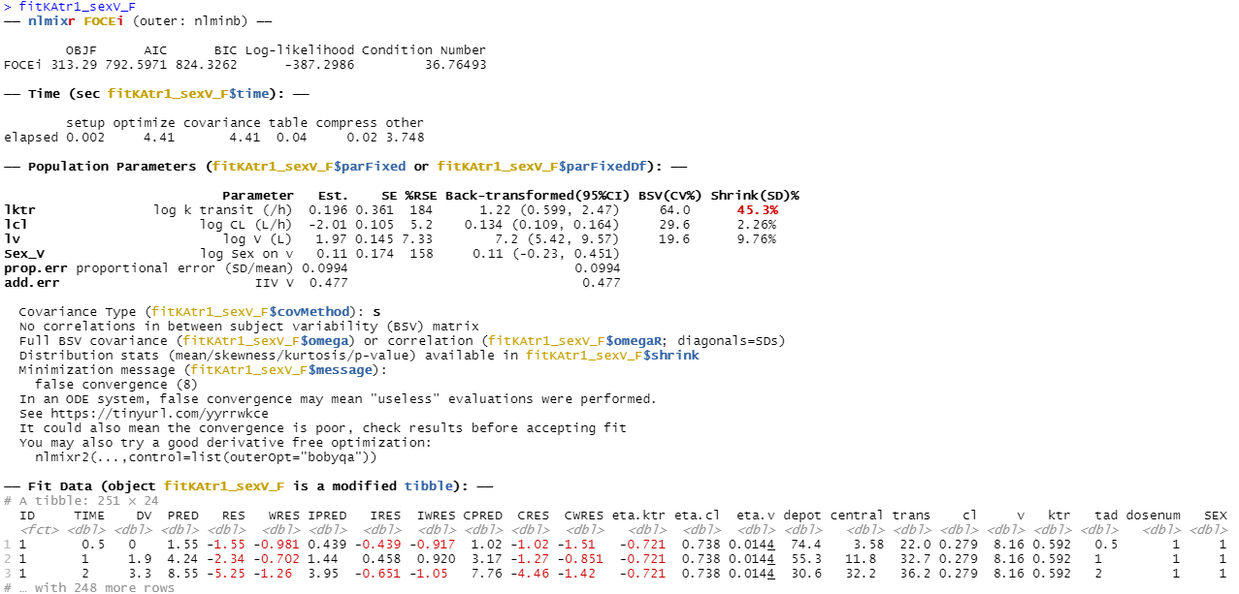
nlmixr² output: mu-referenced sex on V (log-scale)

Slide 87
Parameterisation and mu-referencing
For a binary covariate (e.g. sex 0/1; female/males), the back-transformed estimate is a fold-change that can be re-written as a percentage change
The estimated 0.110 (95%CI: -0.230/0.451) translates using
exp(c(0.110, -0.230, 0.451))
to a fold-change estimate of 1.116 (95%CI: 0.794/1.569)
which corresponds to an increase of 11.6% (95%CI: -20.6%/56.9%)
for males compared to females

Slide 88
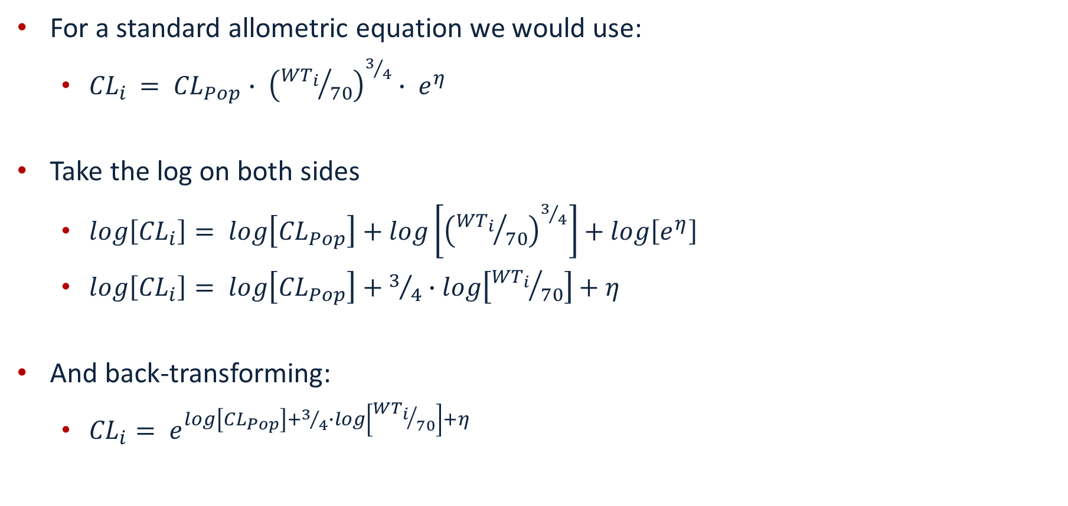
mu-referencing and allometric scaling
For a standard allometric equation we would use:
${CL}_{i }= {CL}_{Pop}∙ {\left({{WT}_{i}}/{70}\right)}^{3/4}∙ e^{η}$
Take the log on both sides
$log\left[{CL}_{i}\right]= log\left[{CL}_{Pop}\right]+log\left[{\left({{WT}_{i}}/{70}\right)}^{3/4}\right]+log\left[e^{η}\right]$
$log\left[{CL}_{i}\right]= log\left[{CL}_{Pop}\right]+3/4∙log\left[{{WT}_{i}}/{70}\right]+η$
And back-transforming:
${CL}_{i}= e^{log\left[{CL}_{Pop}\right]+3/4∙log\left[{{WT}_{i}}/{70}\right]+η}$

Slide 89
Corresponding nlmixr² code
Code is most stable if transformations are carried out in the data file instead of in the model code, especially for SAEM:
## Using standard R syntax: PKdata$logWT70 <- log(PKdata$WT/70) ## Or using data.table syntax PKdata[,logWT70:=log(WT/70)]

Slide 90
Corresponding nlmixr² code: allometric scaling
One.comp.transit.allo <- function() { ini({ lktr <- log(1.15) #log k transit (/h) lcl <- log(0.15) #log Cl (L/hr) lv <- log(7) #log V (L) ALLC <- fix(0.75) #allometric exponent cl ALLV <- fix(1.00) #allometric exponent v prop.err <- 0.15 #proportional error (SD/mean) add.err <- 0.6 #additive error (mg/L) eta.ktr ~ 0.5 eta.cl ~ 0.1 eta.v ~ 0.1 }) model({ #Allometric scaling on weight cl <- exp(lcl + eta.cl + ALLC * logWT70) v <- exp(lv + eta.v + ALLV * logWT70) ktr <- exp(lktr + eta.ktr) d/dt(depot) = -ktr * depot d/dt(central) = ktr * trans - (cl/v) * central d/dt(trans) = ktr * depot - ktr * trans cp = central/v cp ~ prop(prop.err) + add(add.err) }) }

Slide 91
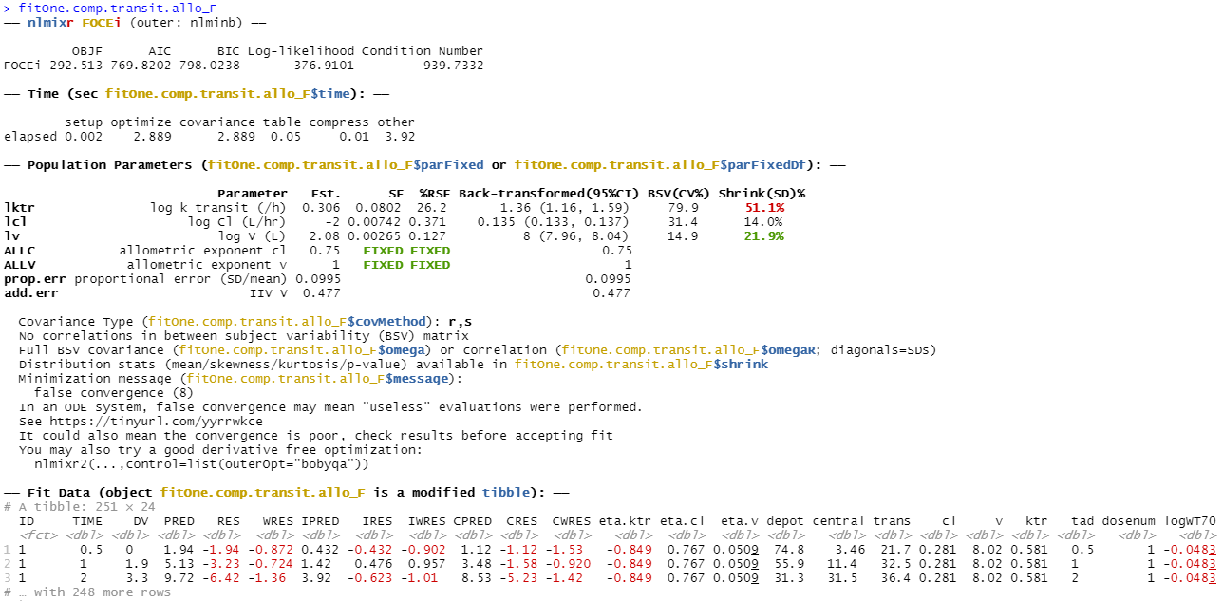
nlmixr² output: allometric scaling ODEs using FOCEi Change in OFV compared to model without allometric scaling: -27.4

Slide 92
Hands-on session IV: running an nlmixr² posthoc analysis and implementing covariates using mu-referencing
Examine the code in PopSim_4.R to run a posthoc analysis
Examine the code in PopSim_4.R to run a covariate analysis with additive on log-scale covariate implementation
Binary covariate (sex)
Continuous covariate (weight)
Modify the allometrically scaled model with fixed exponents to examine what happens when you set them free

Slide 93
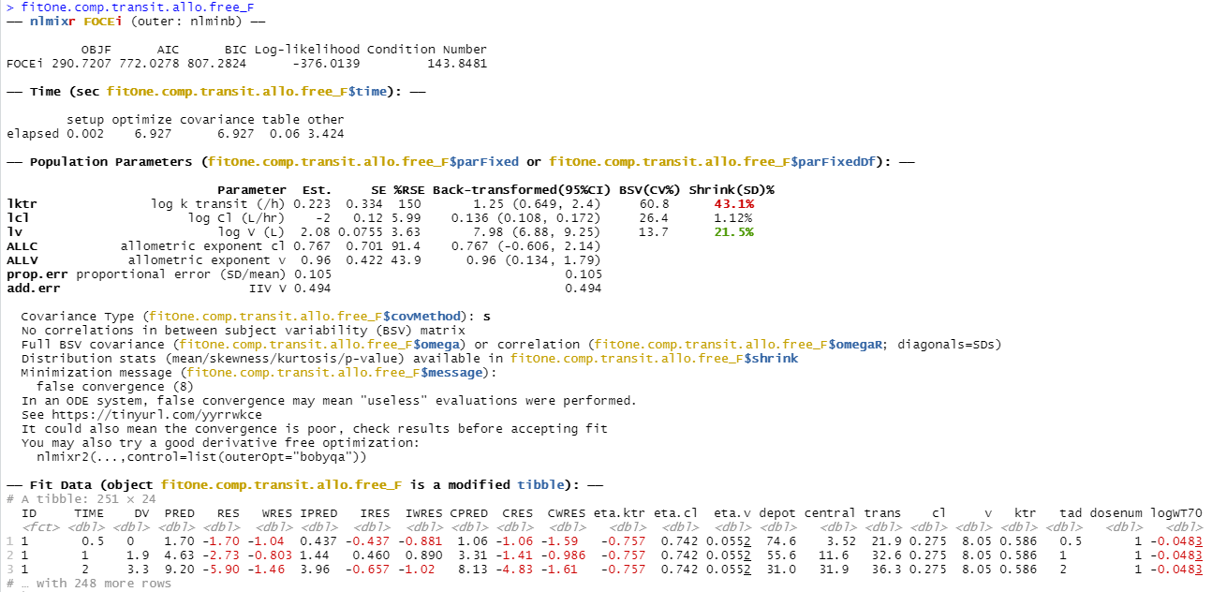
nlmixr² output: allometric scaling ODEs using FOCEI Freely estimated exponents: drop of only 1.79 points

Slide 94
PKPD analysis with nlmixr²: sequential estimation
First approach: use EBEs from a previous PK model to define PK profiles and estimate PKPD relationship
Extract EBEs from nlmixr object and merge to PKPD data file
load(file = "fitOne.comp.transit.allo_F.Rdata") #Use the one compartment transit model to start the PD analysis EBEs <- as.data.table(fitOne.comp.transit.allo_F) EBEs <- EBEs[!duplicated(ID), .(ID = as.numeric(as.character(ID)), IKTR = ktr, ICL = cl, IV = v)] PKPDdata <- fread("warfarin_dat.csv")
#Change variable names to upper case (not strictly necessary) setnames(PKPDdata, names(dataF), toupper(names(dataF)))
#Generate MDV data items PKPDdata[, MDV := ifelse(is.na(DV), 1, 0)] PKPDdata[, MDV := ifelse(AMT > 0, 1, MDV)]
#Merge data with PK EBEs PDdata <- merge(PKPDdata, EBEs, by = "ID", all.x = TRUE)
#Mark the PK measurements from the file to not be analysed PDdata[, MDV := ifelse(DVID == 1 & AMT == 0, 1, MDV)]

Slide 95
PKPD analysis with nlmixr²: define turnover model using PK EBEs
KA1tr1IPP_PDtoemax1 <- function() { ini({ tc50 <- log(1) #log ec50 (mg/L) tkout <- log(0.05) #log tkout (/h) te0 <- log(100) #log e0 eta.c50 ~ .5 eta.kout ~ .1 eta.e0 ~ .1 eps.pdadd <- 100 }) model({ c50 = exp(tc50 + eta.c50) kout = exp(tkout + eta.kout) e0 = exp(te0 + eta.e0) # PK parameters from input data set ktr = IKTR cl = ICL v = IV cp = central/v PD = 1 - cp/(c50 + cp) effect(0) = e0 kin = e0 * kout d/dt(depot) = -ktr * depot d/dt(central) = ktr * trans - cl/v * central d/dt(trans) = ktr * depot - ktr * trans d/dt(effect) = kin * PD - kout * effect effect ~ add(eps.pdadd) }) }

Slide 96
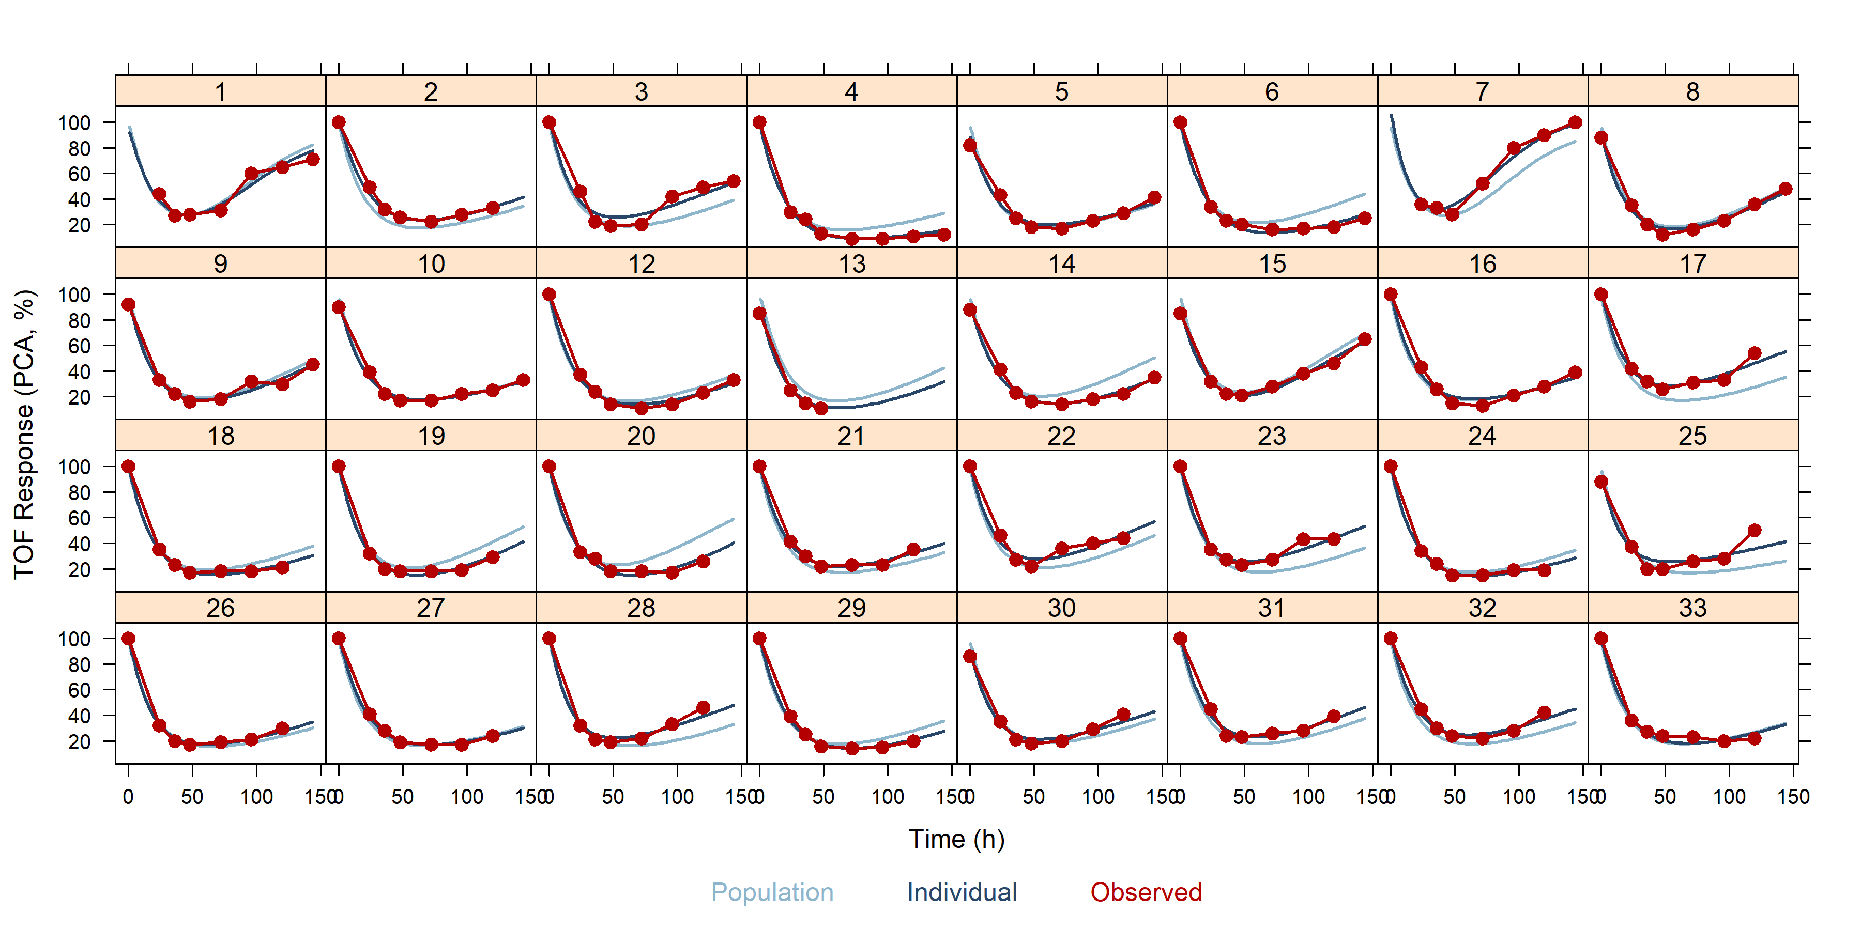
Individual graphs for turnover Emax PD model with PK using EBEs

Slide 97
PKPD analysis with nlmixr²: simultaneous estimation
Second approach: estimate PK and PD simultaneously
The source of observations is identified using a dvid data item
dvid is coded as central and effect in the data object to identify the two types of observation as presented in the model code

Slide 98
Immediate effect simultaneous PKPD analysis with nlmixr²: ini block
#Immediate effect KA1tr1_PDimmemax1 <- function() { ini({ ## PK tktr <- log(1) # log ktr (/h) tcl <- log(0.1) # log CL (L/h) tv <- log(8) # log Vc (L) eta.ktr ~ 1 eta.cl ~ 0.1 eta.v ~ 0.1 eps.pkprop <- 0.1 #proportional error (SD/mean) eps.pkadd <- 0.4 #additive error (mg/L)
## PD tc50 <- log(1) #log ec50 (mg/L) te0 <- log(100) #log e0 eta.c50 ~ .5 eta.e0 ~ .1 eps.pdadd <- 100 }) model({
}) }

Slide 99
Immediate effect simultaneous PKPD analysis with nlmixr²: model block
#Immediate effect model({ ktr <- exp(tktr + eta.ktr) cl <- exp(tcl + eta.cl) v <- exp(tv + eta.v) c50 = exp(tc50 + eta.c50) e0 = exp(te0 + eta.e0) cp = central/v d/dt(depot) = -ktr * depot d/dt(central)= ktr * trans - cl * cp d/dt(trans) = ktr * depot - ktr * trans effect = e0 * (1 - cp/(c50 + cp)) cp ~ prop(eps.pkprop) + add(eps.pkadd) | central effect ~ add(eps.pdadd) | effect }) }

Slide 100
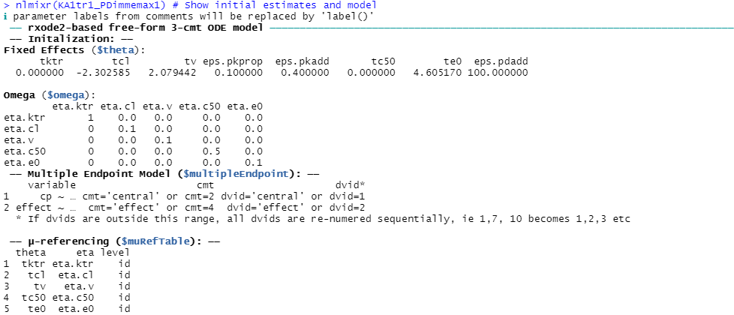
Simultaneous PKPD analysis with nlmixr²: examine defined model
nlmixr2(KA1tr1_PDimmemax1) # Show initial estimates and model information:

Slide 101
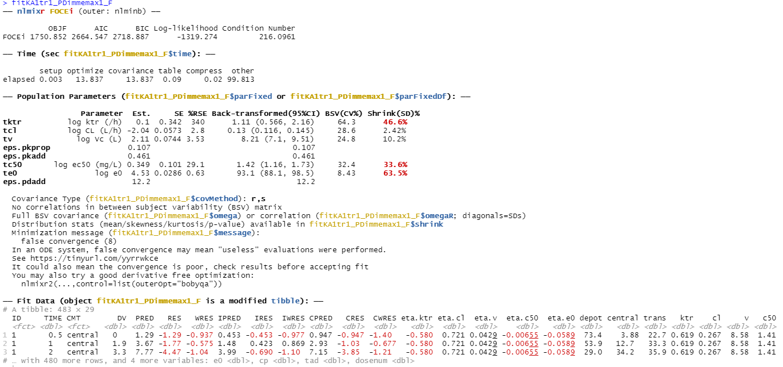
nlmixr² output: immediate effect simultaneous PKPD model

Slide 102
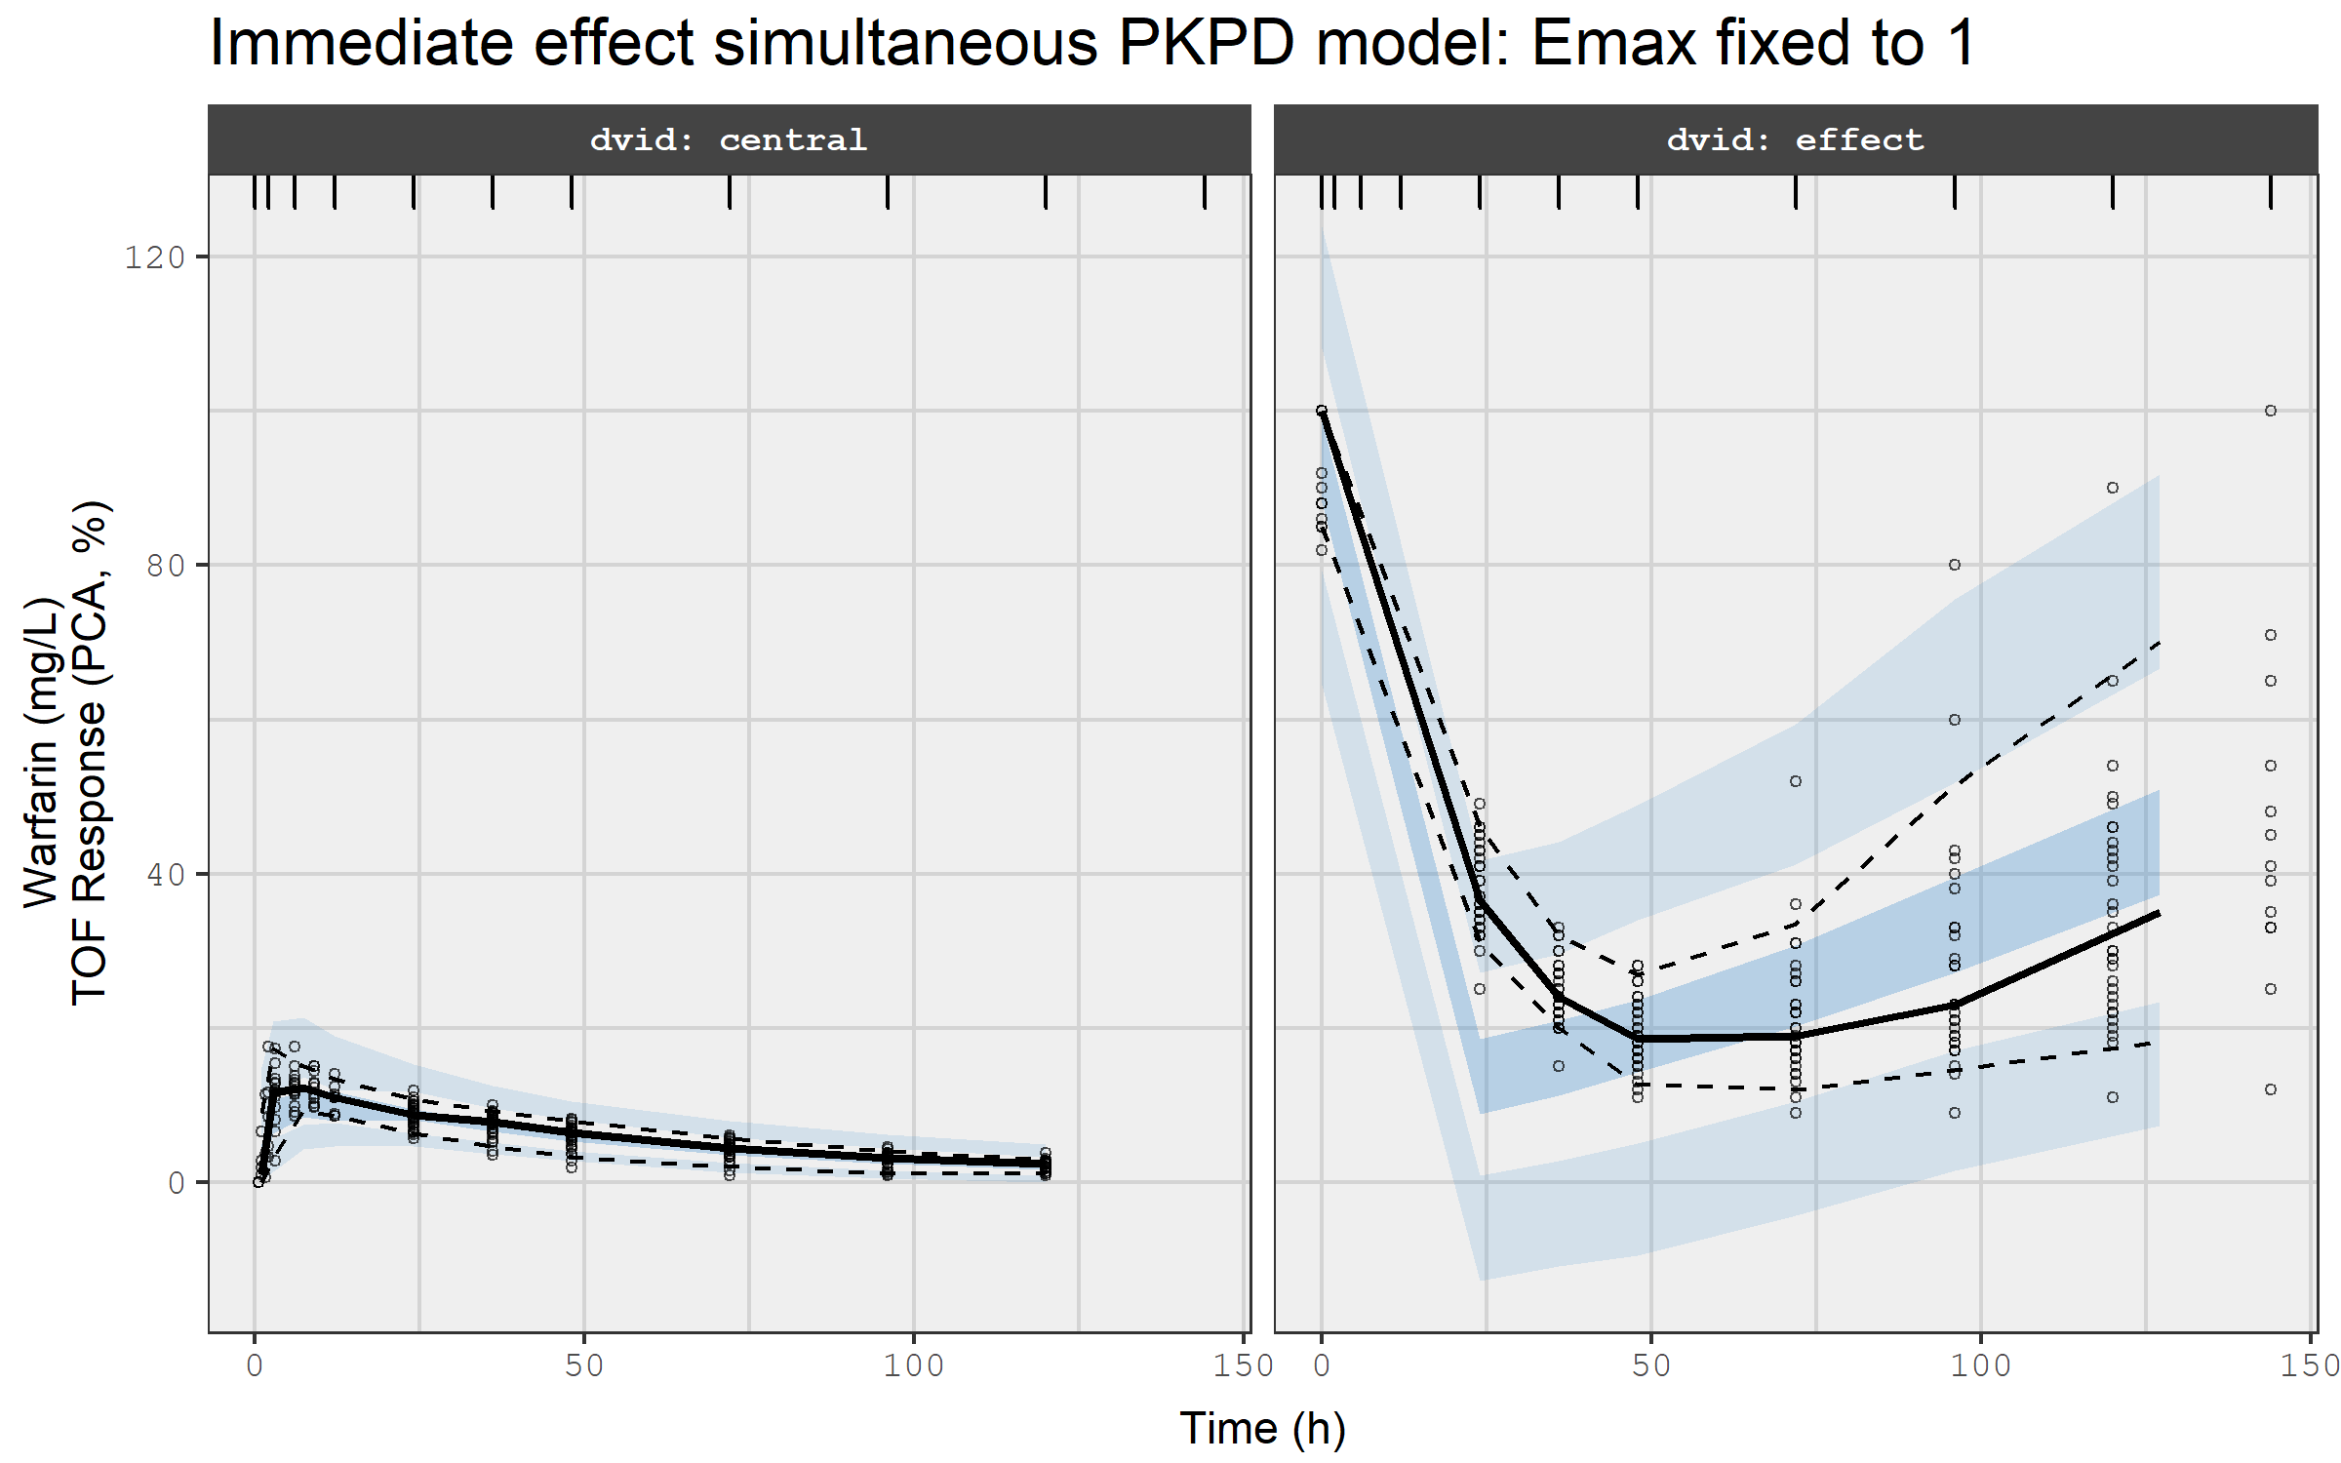
VPC for immediate effect simultaneous PKPD model

Slide 103
Effect compartment simultaneous PKPD analysis with nlmixr²: ini block
#Effect compartment model KA1tr1_PDceemax <- function() { ini({ ## PK tktr <- log(1) # log ktr (/h) tcl <- log(0.1) # log CL (L/h) tv <- log(8) # log Vc (L) eta.ktr ~ 1 eta.cl ~ 0.1 eta.v ~ 0.1 eps.pkprop <- 0.1 #proportional error (SD/mean) eps.pkadd <- 0.4 #additive error (mg/L) ## PD tc50 <- log(1) #log ec50 (mg/L) tkout <- log(0.05) #log tkout (/h) te0 <- log(100) #log e0 eta.c50 ~ .5 eta.kout ~ .1 eta.e0 ~ .1 eps.pdadd <- 100 }) model({
}) }

Slide 104
Effect compartment simultaneous PKPD analysis with nlmixr²: model block
#Effect compartment model model({ ktr <- exp(tktr + eta.ktr) cl <- exp(tcl + eta.cl) v <- exp(tv + eta.v) c50 = exp(tc50 + eta.c50) kout = exp(tkout + eta.kout) e0 = exp(te0 + eta.e0) emax = 1 cp = central/v d/dt(depot) = -ktr * depot d/dt(central)= ktr * trans - cl * cp d/dt(trans) = ktr * depot - ktr * trans d/dt(ce) = kout * (cp - ce) effect = e0 * (1 - emax * ce/(c50 + ce)) cp ~ prop(eps.pkprop) + add(eps.pkadd) | central effect ~ add(eps.pdadd) | effect }) }

Slide 105
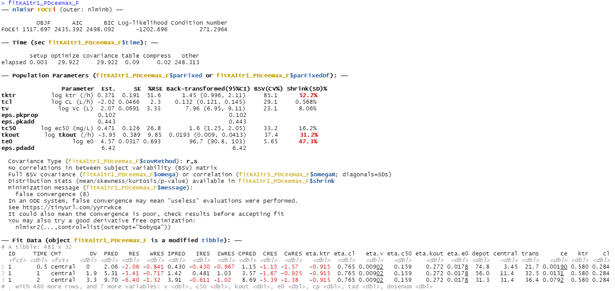
nlmixr² output: effect compartment simultaneous PKPD model

Slide 106

VPC for effect compartment simultaneous PKPD model

Slide 107
Turnover model simultaneous PKPD analysis with nlmixr²: ini block
#Turnover simultaneous PKPD model KA1tr1IPP_PDtoemax <- function() { ini({ ## PK tktr <- log(1) # log ktr (/h) tcl <- log(0.1) # log CL (L/h) tv <- log(8) # log Vc (L) eta.ktr ~ 1 eta.cl ~ 0.1 eta.v ~ 0.1 eps.pkprop <- 0.1 # proportional error (SD/mean) eps.pkadd <- 0.4 # additive error (mg/L) ## PD tc50 <- log(1) #log ec50 (mg/L) tkout <- log(0.05) #log tkout (/h) te0 <- log(100) #log e0 eta.c50 ~ .5 eta.kout ~ .1 eta.e0 ~ .1 eps.pdadd <- 100 }) model({
}) }

Slide 108
Turnover model simultaneous PKPD analysis with nlmixr²: model block
#Turnover simultaneous PKPD model model({ ktr <- exp(tktr + eta.ktr) cl <- exp(tcl + eta.cl) v <- exp(tv + eta.v) c50 = exp(tc50 + eta.c50) kout = exp(tkout + eta.kout) e0 = exp(te0 + eta.e0) emax = 1 cp = central/v d/dt(depot) = -ktr * depot d/dt(central)= ktr * trans - cl * cp d/dt(trans) = ktr * depot - ktr * trans effect(0) = e0 kin = e0 * kout PD = 1 - emax * cp/(c50 + cp) d/dt(effect) = kin * PD - kout * effect cp ~ prop(eps.pkprop) + add(eps.pkadd) | central effect ~ add(eps.pdadd) | effect }) }

Slide 109

nlmixr² output: turnover simultaneous PKPD model

Slide 110

VPC for turnover simultaneous PKPD model

Slide 111

VPCs to compare the immediate effect model, the effect compartment model, and the turnover simultaneous PKPD model

Slide 112
Hands-on session V: running nlmixr² PKPD analysis
Examine the code in PopSim_5.R to run the sequential or one of the simultaneous PKPD analyses

Slide 113
Hands-on bonus session VI: importing NONMEM output and running nlmixr² utilities
Examine the code in PopSim_6.R to read in the provided run005 NONMEM results and create individual plots, simulations, VPCs, and rerun the model using nlmixr²

